Slide 1


RAAD Pathfinding Exit
Joe Tarango (Principal Investigator, Machine Learning Scientist, Telemetry 2.0 Architect, & Adjunct Professor CU Boulder)
Team:
Daniel Garces, Rogelio Macedo, Sungkeun Kim, Stella Cao, PanteA Zardoshti, Tyler Woods,
Andrea Chamorro, Brad MacDonald (Penn Intern on loan from IL), Jim Baca
NPSG/IOG Collaborators: Randy Eike, Phuong Tran
Strong Collaboration with Intel Labs Machine Programming Research (MPR):
Justin Gottschlich (Principal AI Scientist & Director of Machine Programming Research) & MPR Team
Notes:
Presenter: Jim – We have many slides to cover in a short time. Please enter questions into chat and we will address them at the end in Q&A section.
PESG = Product Enablement Solutions Group – TFM part of IPSG (Infrastructure & Platform Solutions Group)
DPG = Data Platforms Group
CESG = Cloud & Enterprise Solution Group
IAGS = Intel Architecture, Graphics & Software
CCG = Client Computing Group

Slide 2

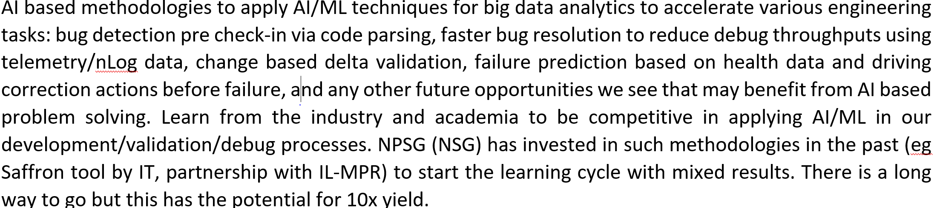
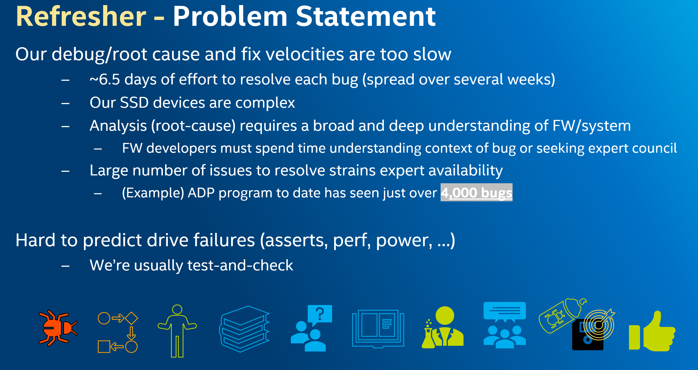
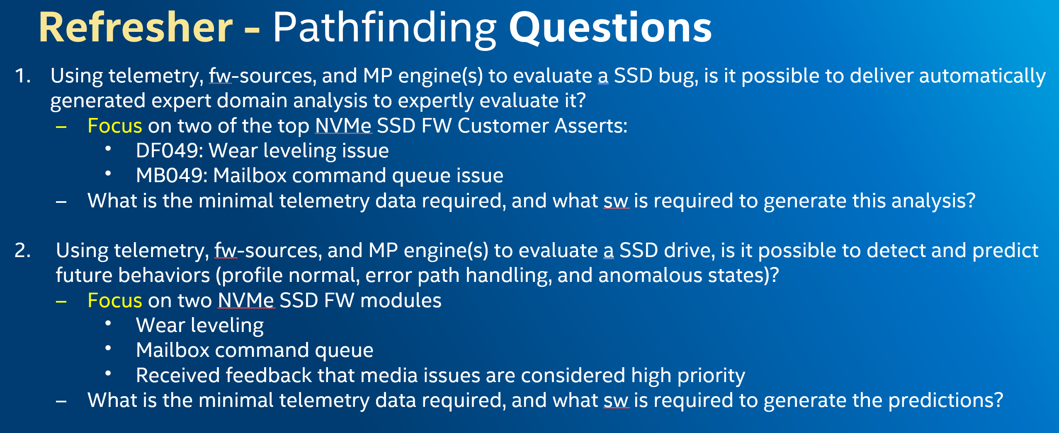
RAAD Quick Overview
Objective: Rapid Automated Analysis of input data producing:
Automated expert context for debug/bug burndown acceleration (target: FW developers).
Automated drive profiling to forecast and predict future behaviors (target: Host Policy – to mitigate future drive issues)
Key Messages:
Framework in place
Install wizard available for users of RAAD and developers of RAAD Link
Reports being generated for DF asserts
Able to Forecast future media behaviors in drives (Alibaba SMART data)
Dependent on assert data in Debug Handbook and on Data Lake/AXON
Need to establish Productization co-ownership for deployment
Scale to more customer asserts (BHB, ADPRR), then scale to all asserts
Train developers on how to use RAAD
Pathfinding additional algorithms/capabilities
Continue to Patent new capabilities and submit academic whitepapers
RAAD objective is to accelerate debug burndown and predict drive issues
Notes:
Presenter: Jim
*Notes: Input data includes FW-source, defect info, debug-handbook, smart data and extensive telemetry. Approver changed from Frank to Prasanna.
Recorded demo video – RAAD End-to-end Flow
We are augmenting me for debug analysis and predictability.
Here are a few highlights:
Framework is complete
Able to generate content at 60%
We can scale our algorithms to media characterization.
In today’s performing state, it takes 6.5 days of effort to resolve bug and the timeframe to resolve it can linger for several weeks. The challenge is the resolution at its core is due to complexity of relational polices, mechanisms, exchanges, and events. Consequently, the resolution requires a broad and deep understanding to address these faulting and anomalous states. The most optimized approach to solve these challenges are to develop task forces consisting of experts in various domains. To provide a background on the volume of the a given product program, we queried JIRA and were surprised to see over 3000 observed total bugs as of last week. The sheer volume explains the limited availability of experts and these were exposed through our continuous validation testing. The resolution of these were typically completed through the cycle of development, experiment, and re-testing with predicting outcomes ahead of time being on the order of complexity to solve the bug.
The impact of saving 0.1 person days of effort per bug (i.e. 0.8 person hours). Would yield 2,400 hours saved (0.8 person hours times 3,000 = 2400 person hours). When taking these into account a highly productive work week of 40 hours, we see on the order of 60 engineering weeks saved.

Slide 3
Risks/Mitigation
Risks:
Feedback on ease of use and usefulness of RAAD
Data-lake (DL)/Axon
Telemetry/system meta uploaded to DL/Axon (ConVal, PV, RDT and Customer)
Debug Handbook wiki assert content (“Known Causes for Assert” and “FW Data Necessary for Analysis” )
Scaling
Firmware stability – Data-Control, PacManIC.py, Auto-Parsers, and telemetry swim lane
Mitigation (in order per above):
Gain approval for a subset of FW developers to evaluate RAAD’s ease of use and usefulness
Current DL/Axon owners to ensure that DL/Axon instances are planned for NPSG (or create a database)
Telemetry (Tel) and validation teams to upload Tel and RAAD system meta to DL/Axon
CSE FW team to add content into debug handbook
CSE FW assistance with specifics for each assert type
Experienced developers applied to ensure firmware stability
Notes:
Presenter: Jim
FW stability -Experienced developers such as Randy or Phuong should have support to ensure these are stable.
Access to AGS “NSG Users General Projects” needed by users of RAAD (in order to have access to crawl the Debug Handbook)
Ensure all RAAD users have access to “NSG Users General Projects”

Slide 4
Requirements for BHB/RAAD
Standardize the Asserts
Debug Handbook wiki assert content (“Known Causes for Assert” and “FW Data Necessary for Analysis”)
Firmware stability – Data-Control, PacManIC.py, Auto-Parsers, and telemetry swim lane
Scale up RAAD to analyze additional asserts
Telemetry/system meta uploaded to DL/Axon (ConVal, PV, RDT and Customer)
Easily accessible telemetry
Database to store telemetry (RAAD modified to access this database – in Gen 3 we used Datalake/AXON)
HWPC inside telemetry (maybe its own object ID)
Periodic pulls of HIT (perhaps in ConVal swim lane)
Notes:
Presenter: Jim
FW stability -Experienced developers such as Randy or Phuong should have support to ensure these are stable.
Access to AGS “NSG Users General Projects” needed by users of RAAD (in order to have access to crawl the Debug Handbook)
Ensure all RAAD users have access to “NSG Users General Projects”

Slide 5

Answering the first Pathfinding Question
Using Telemetry, fw-sources, and MP engine(s) to evaluate an SSD bug, is it possible to deliver automatically generated expert domain analysis to expertly evaluate it? (scope: DF and MB asserts)
Yes, RAAD can quickly and automatically generate expert domain analysis reports for FW developers
Several FW developers evaluated the RAAD report (see next few slides) and confirmed that the data was quite useful
What is the minimal telemetry data required and what SW is required to generate the analysis?
Minimum data required
Telemetry binary (CIT and HIT – Pertinent Data Objects ID’s in Debug Handbook)
System Meta (as specified by RAAD)
FW (from git repo)
Codified Debug Handbook
Historical Jira data (supervised classification techniques - ex. K-nearest neighbor with a standard distance-metric and/or feature search)
SW required
GCC, LLVM, and GHS
Modules
Anaconda (Python system module), LaTeX (pdf generation), Telemetry auto parsing (cross compiler and python scripts), System meta (python scripts), Time-series visualization, Data management Linkage, Machine Programming Engines (MPE), Data Aggregation into Intel’s oneAPI, data processing.
ControlFlag (IL MPR) RAAD API and additions in MISM/Auto-Perf
Artificial Intelligence (AI), Machine Learning (ML), etc. - Ensemble methods were created for diversity in technologies.
Vector Decomposition, Latent Semantic Analysis
Cosine Similarity, Dynamic Time Warping, K-Nearest Neighbor, Motif Discovery, Matrix Profile, Fast Low-Cost Unipotent Semantic Segmentation (FLUSS), Mudeen’s Ultra Fast Algorithm for Similarity Search (MASS), Huffman Encoding
T-Distributed Stochastic Neighboring Entities (TSNN), Principal component analysis
Syntax Autocorrect, Bayesian Decision tree, Self Organizing Map, Abstract Syntax Tree, Context-Aware Semantic Structure (CASS)
Recurrent Neural Network (RNN), Long-Term Short-Term Memory (LSTM), Graph Neural Network (GNN), Neural Code Comprehension (NCC), Transformers, Natural Language Processing
Yes! Preparing more real-world developer feedback…
Notes:
Presenter: Joe

Slide 6
RAAD & MPR Data Flow – Methods and Apparatuses
1. Capture
Access Meta through automation in collection
2. Store & Extract
Access saved dataset
3. Parse
Use automated flow for extraction of content into formats
4. Analyze
Use engines to perform tasks on analysis.
5. Report
Generate code for LaTeX
Save meta data locally
Compress data for storage
From Capture to Report in $≈$15 minutes!
* Dataset size can change analysis time so high-performance server analysis computes much faster ☺.
Notes:
Presenter: Joe

Slide 7
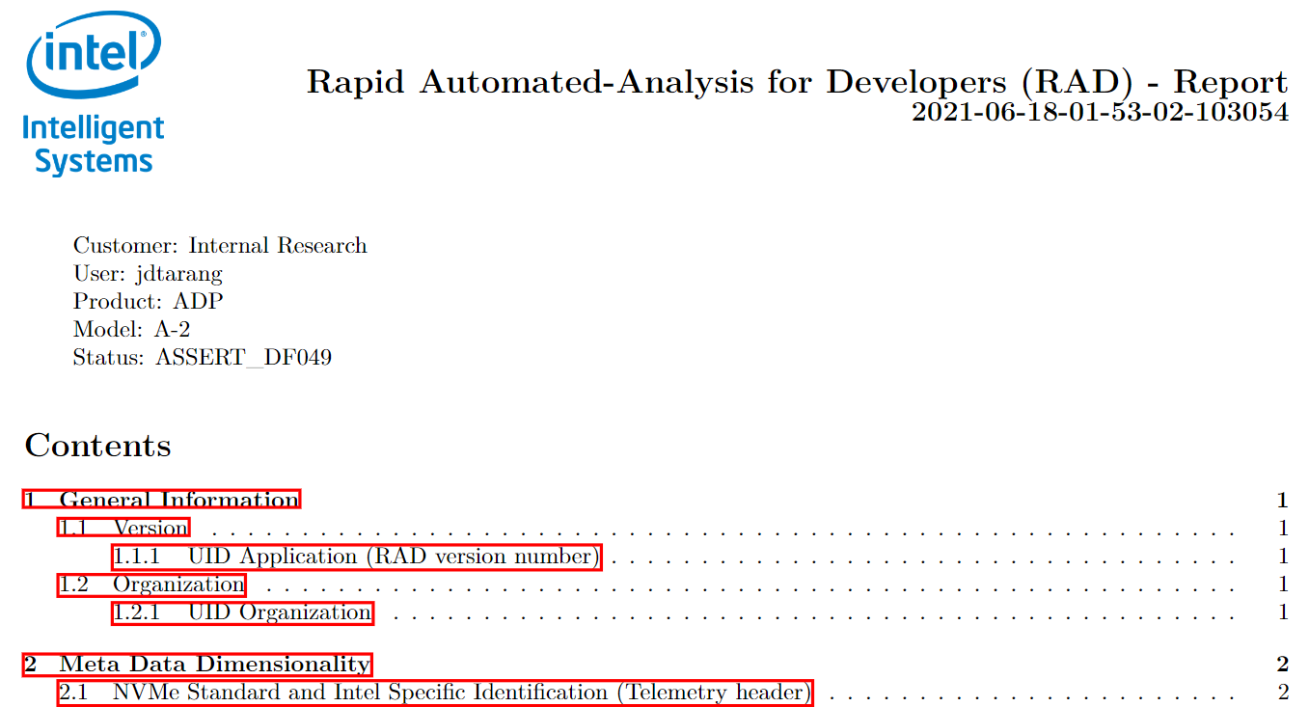
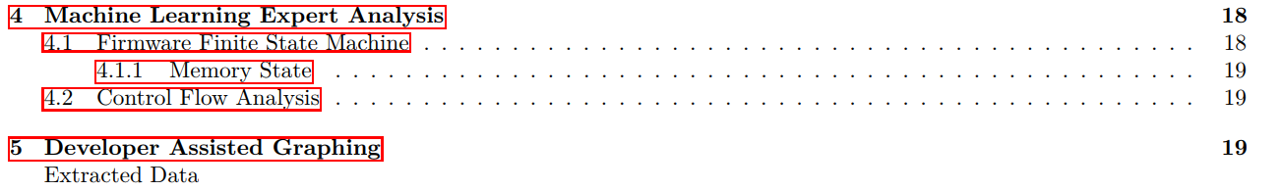
The Expert Content Report – Sample ToC
General Information Collection of information related around the RAAD API version, developer/power-user/user classification, local collection information
Meta Data Dimensionality Labeling of telemetry data objects found
Time Series Time Series summary of algorithms, labeling, models, expansion of datasets
Machine Learning Expert Analysis Summary DFA, CFG, DFG, maps of firmware, and speculative root cause classification.
Firmware Finite State Machine Summary DFA, CFG, DFG, and maps of firmware. Memory, Control Flow, and Data Flow state in transitions maps from binary image.
Developer Assisted Graphing Artificial Intelligence characteristics based on input meta data used in predictive classification, value, state forecasting etc.
(RAAD Report Snippet)
All debug info pertinent to specific telemetry binary in one pdf (ex. DF049)
Notes:
Presenter: Joe

Slide 8
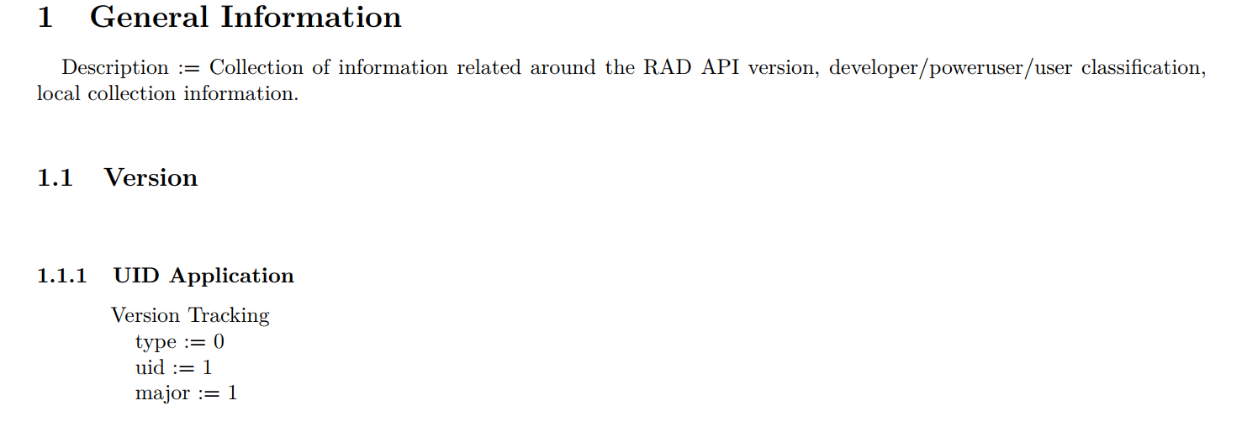
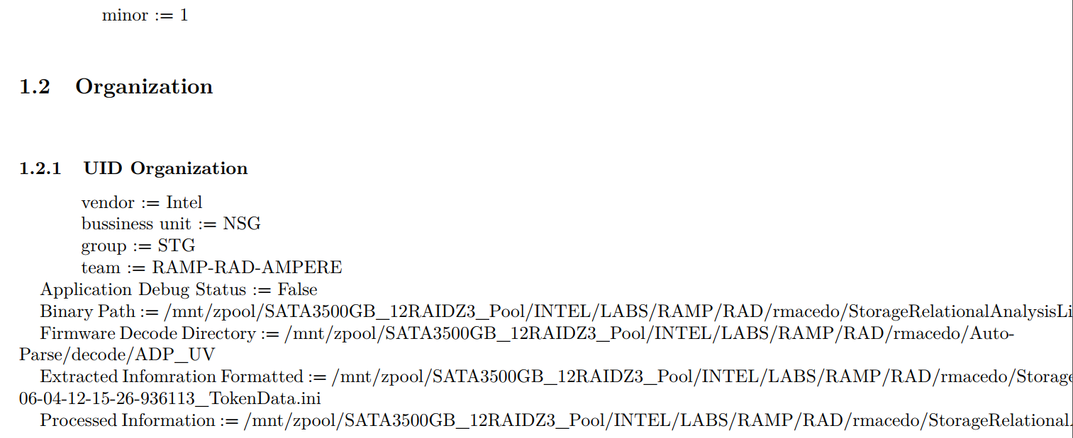
The Expert Content Report – General Information
General Information Collection of information related around the RAAD API version, developer/power-user/user classification, local collection information
How does this help debug?
Streamlines data to engineers in a rapid and novel manner
Data states
Changes over time
Event logs
Summaries
BKM Templated graphical visualizations
Provides intuition for similar
Code
Data objects
JIRA
Profiles
Characterize
Extract Signatures
Construct modes based on observed states
Predict future states based on accuracy windows
Code
Anomalous signatures
Task and OS paths (WIP)
(RAAD Report Snippet)
No longer need to search for basic meta surrounding issue…
Notes:
Presenter: Joe

Slide 9
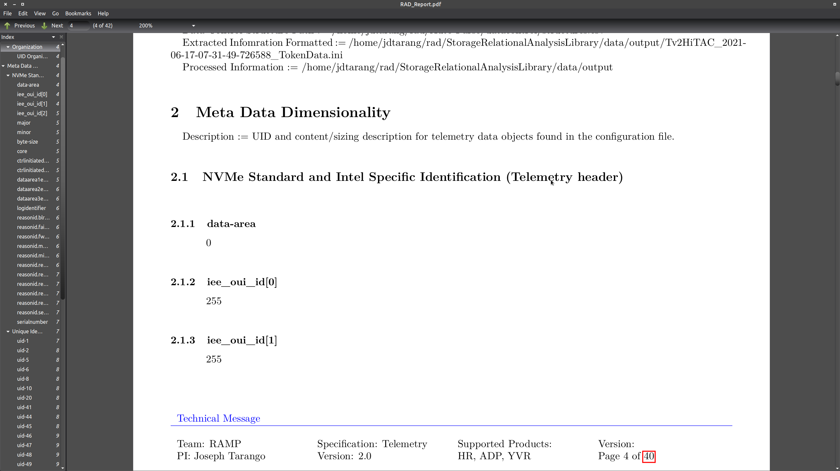
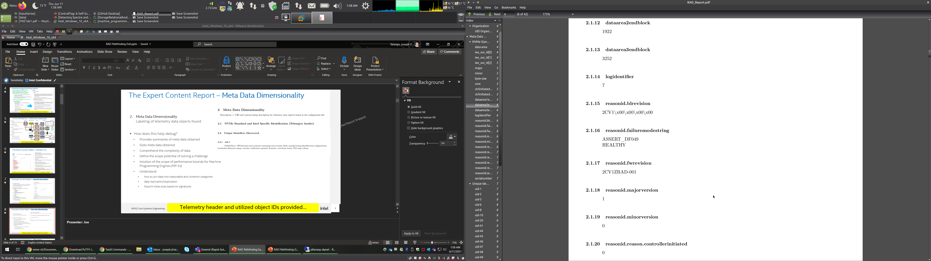
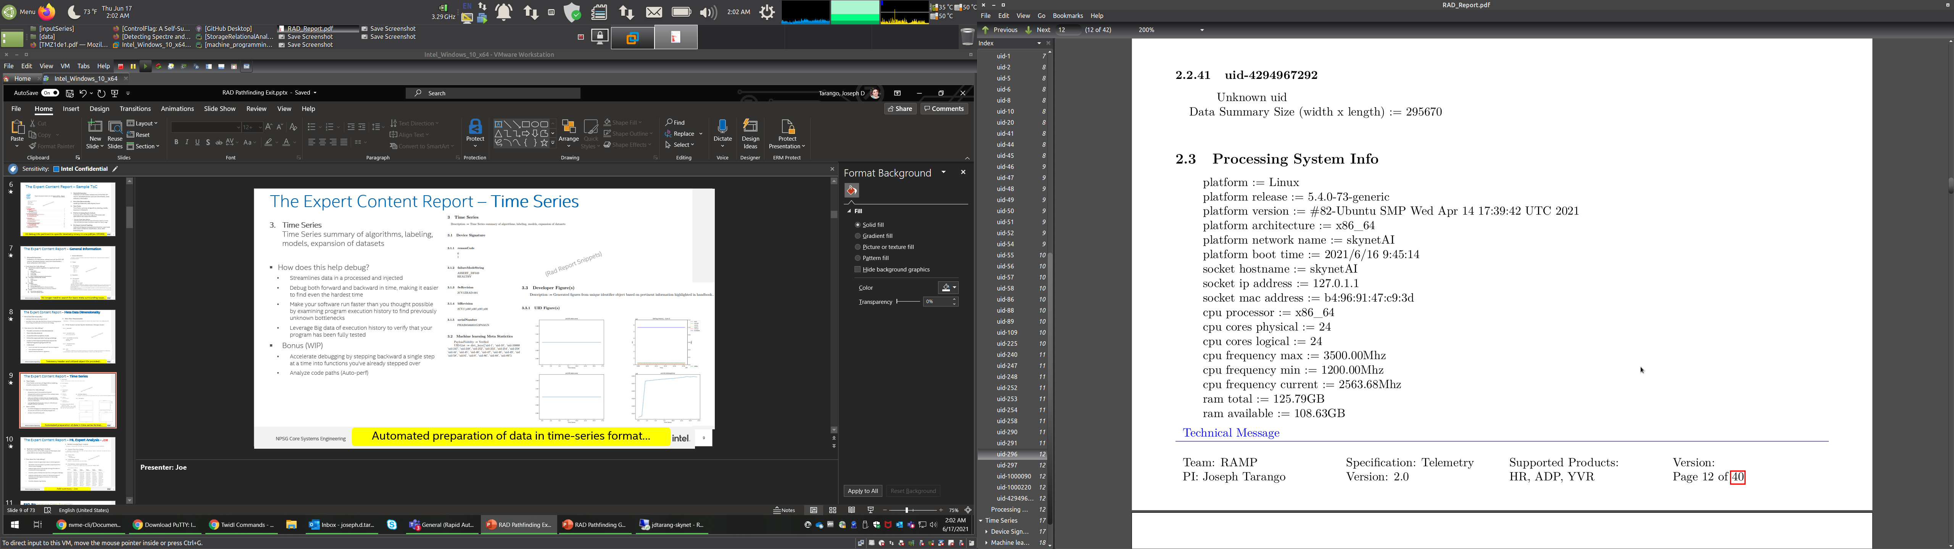
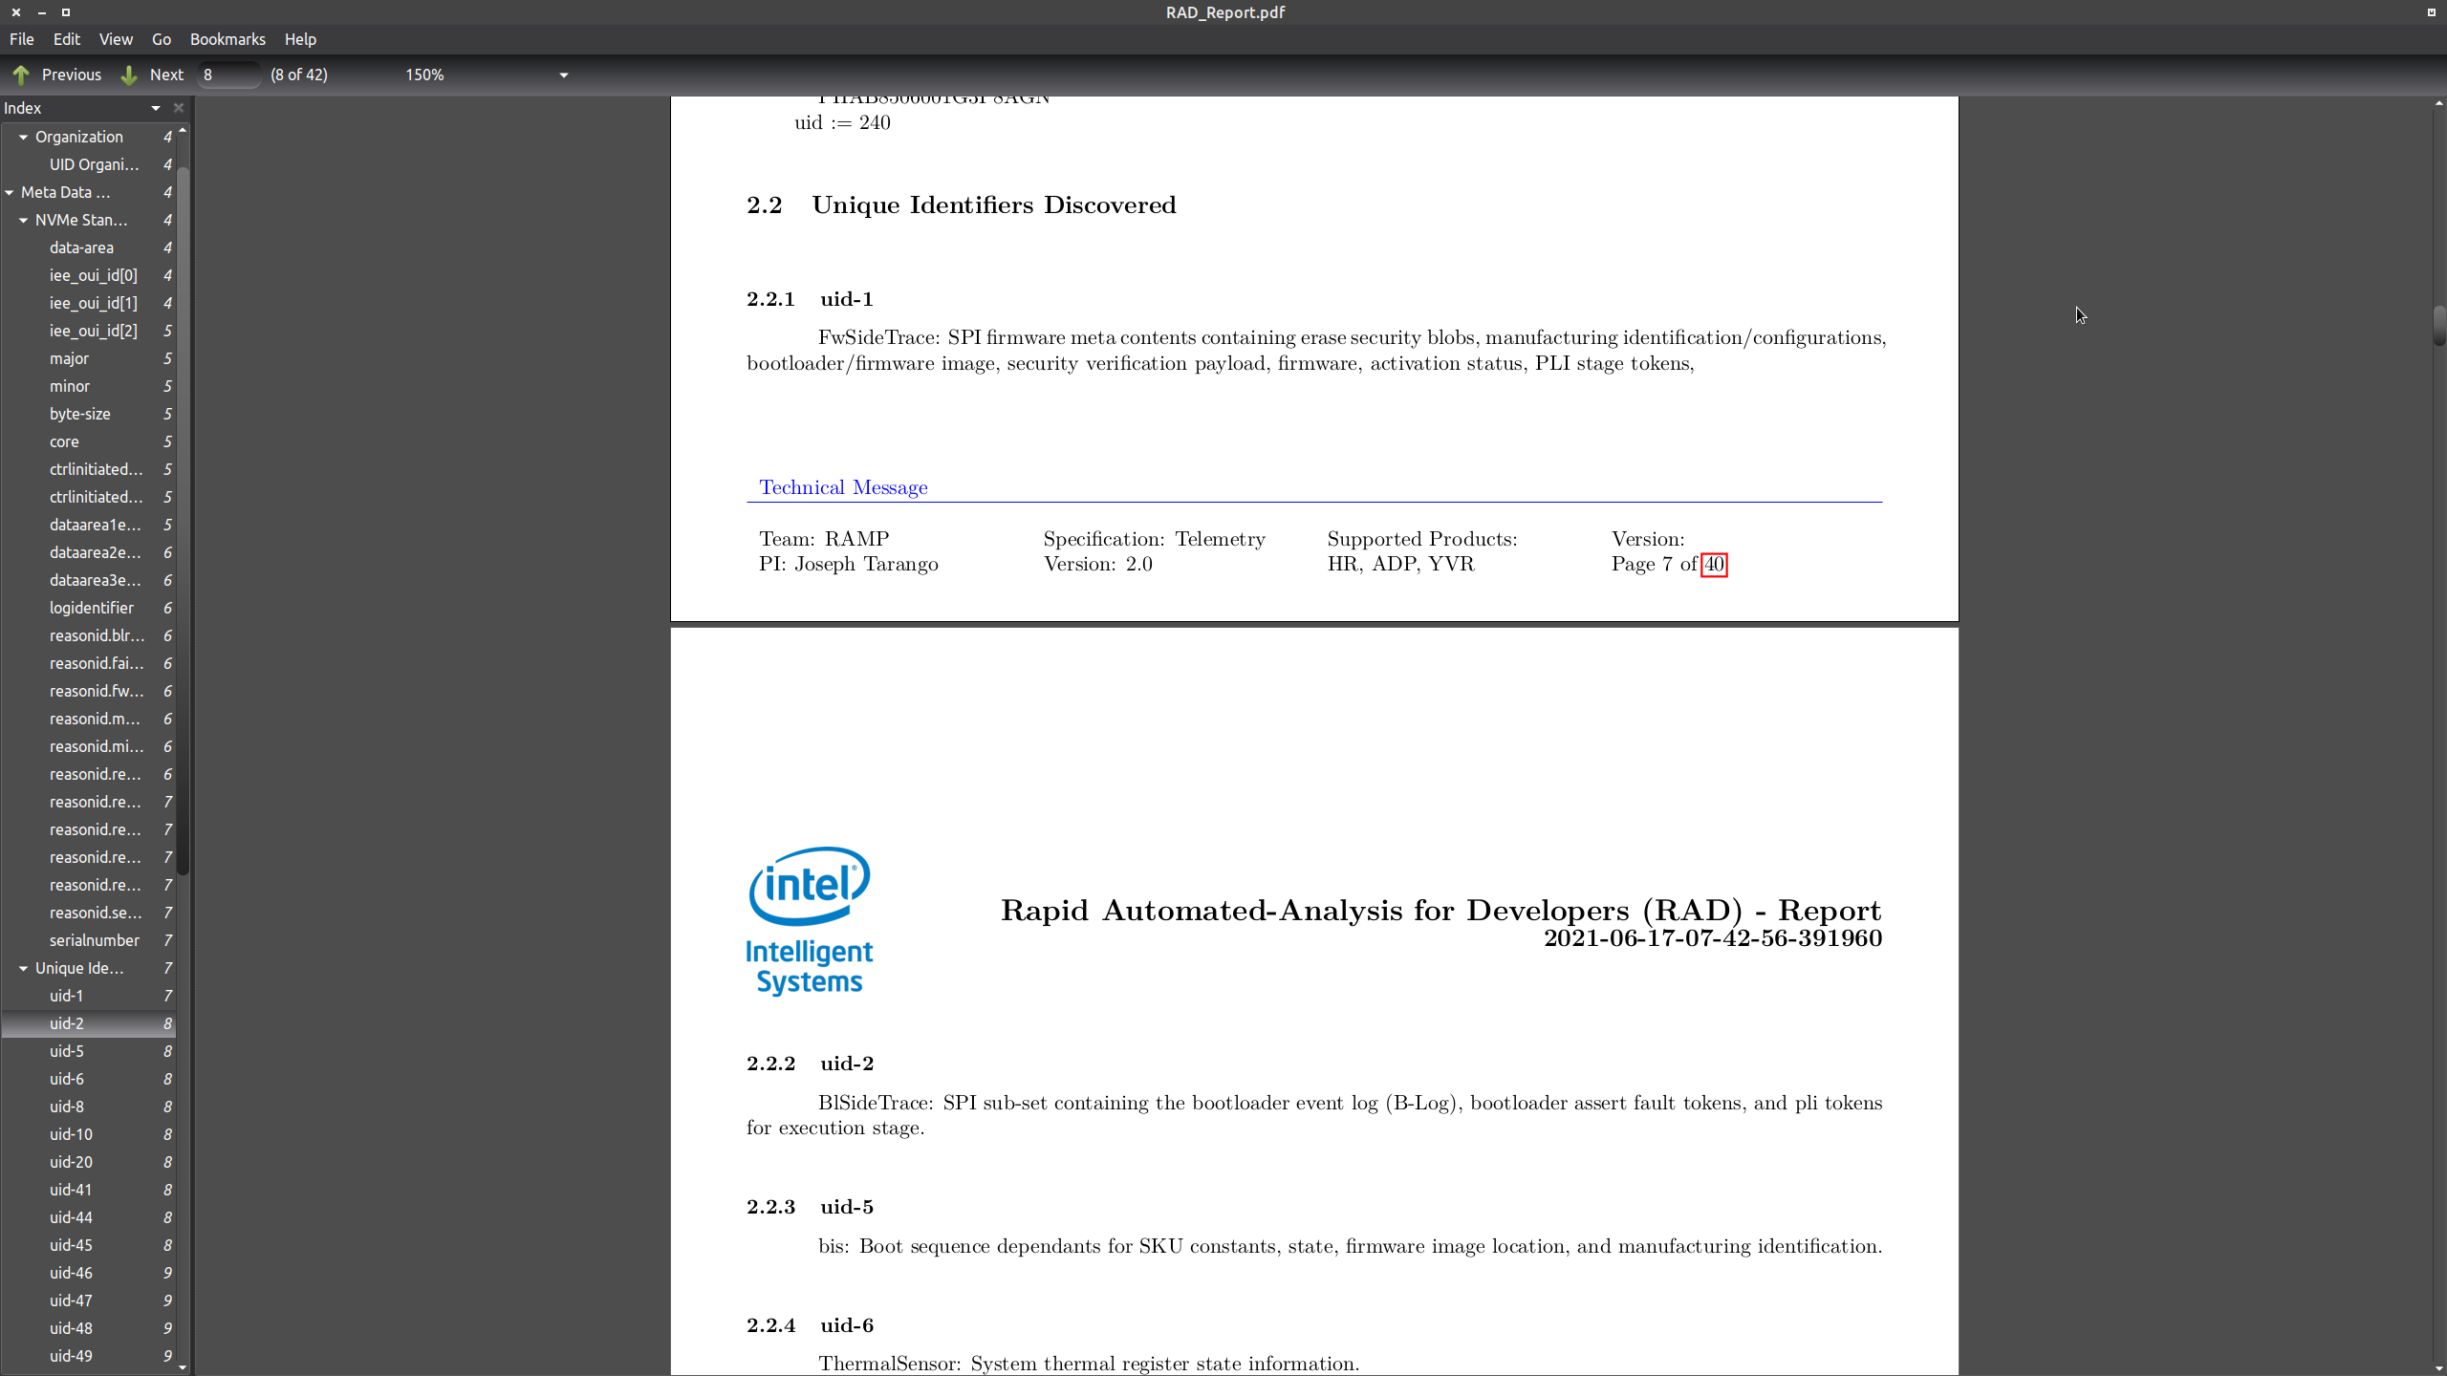
The Expert Content Report – Meta Data Dimensionality
Meta Data Dimensionality
Labeling of telemetry data objects found.
Used data control meta data found from previous working group to create debug handbook process, format, and strategy.
How does this help debug?
Provides summaries of meta data obtained
Sizes meta data obtained
Comprehend the complexity of data
Define the scope potential of solving a challenge
Intuition of the scope of performance bounds for Machine Programming Engines (MP-Es)
Understand:
how to join data into reasonable and coherent categories
data replication/duplication
Disjoint meta sizes based on signatures
(RAAD Report Snippets)
Telemetry header and utilized object IDs provided…
Notes:
Presenter: Joe

Slide 10
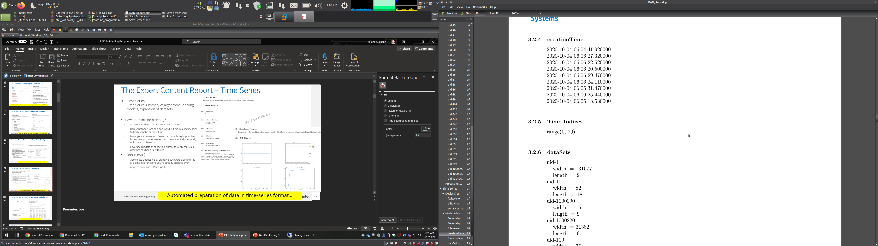
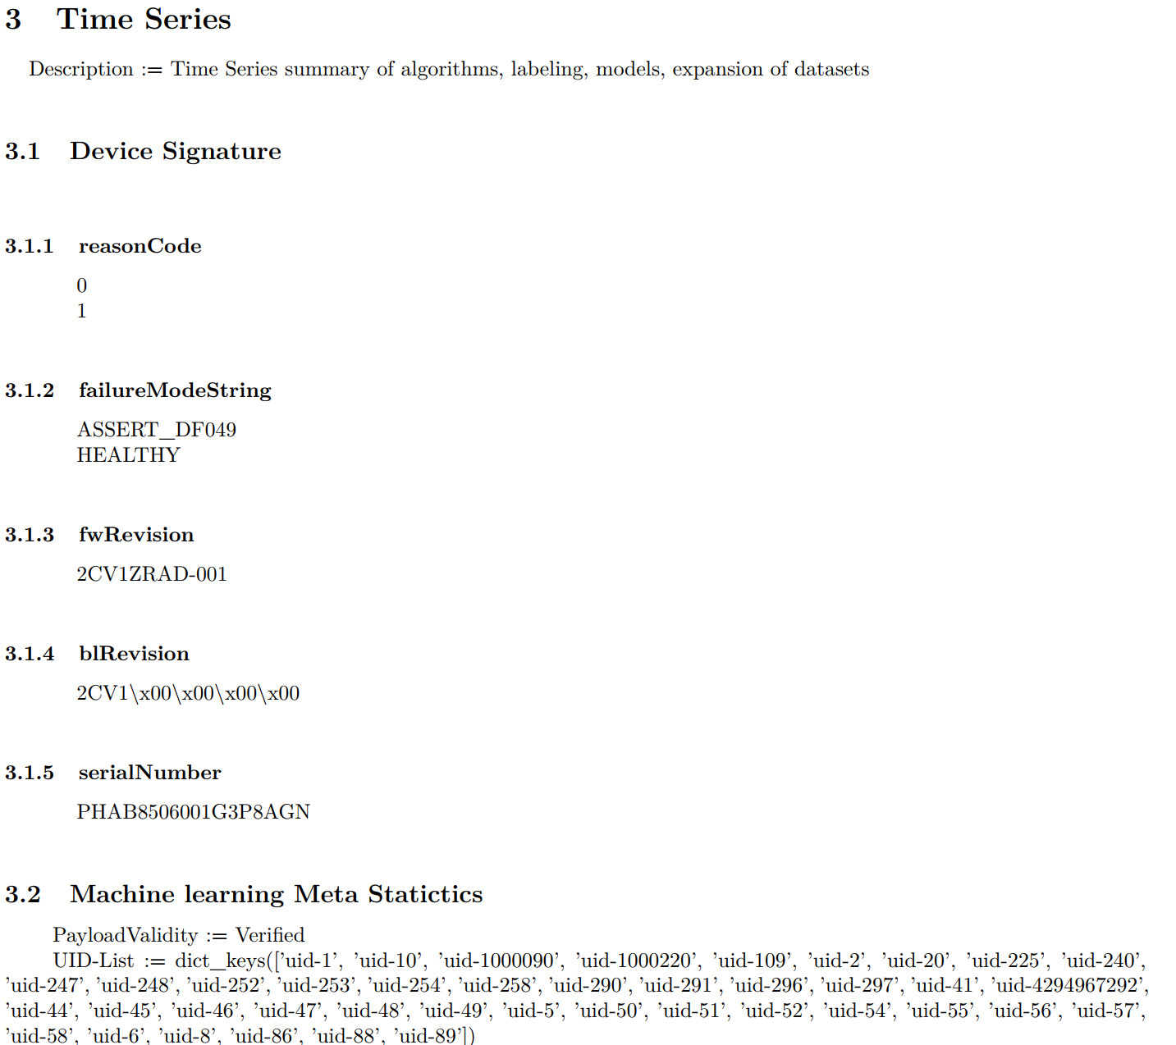
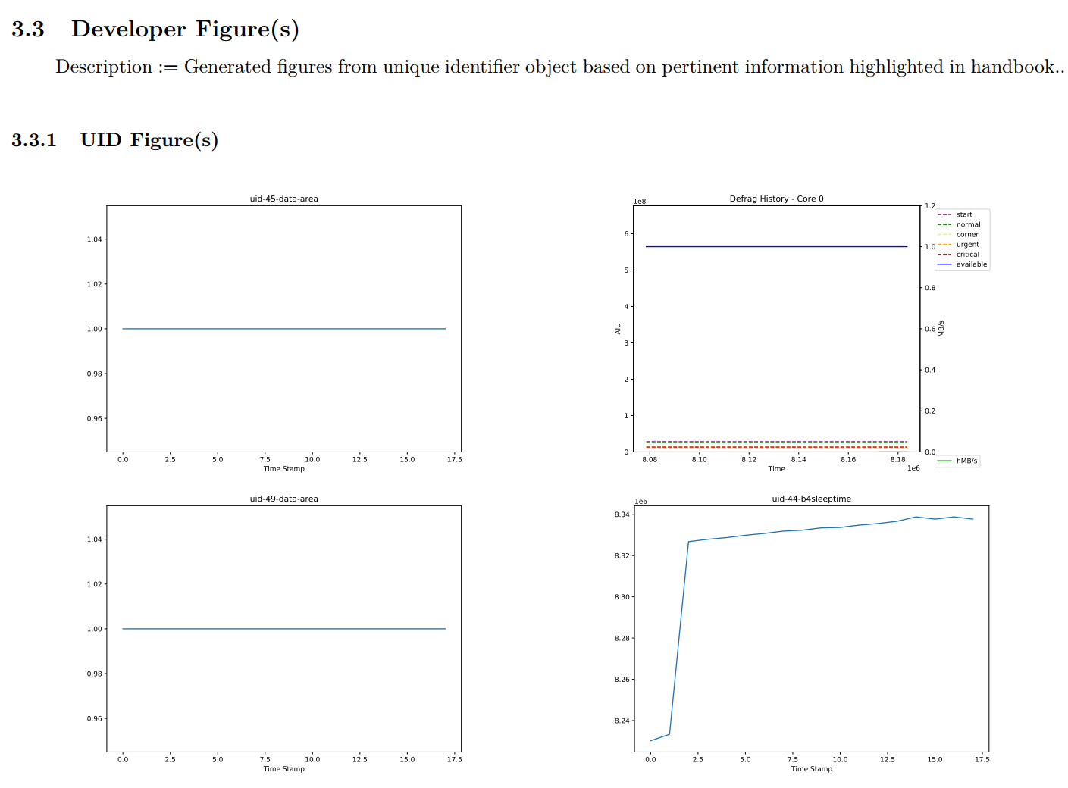
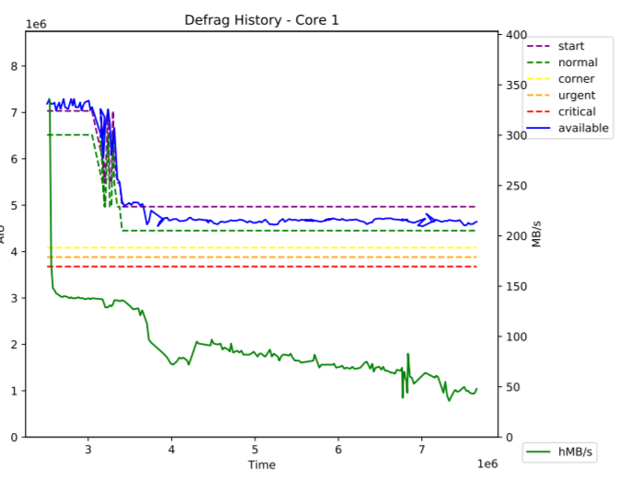
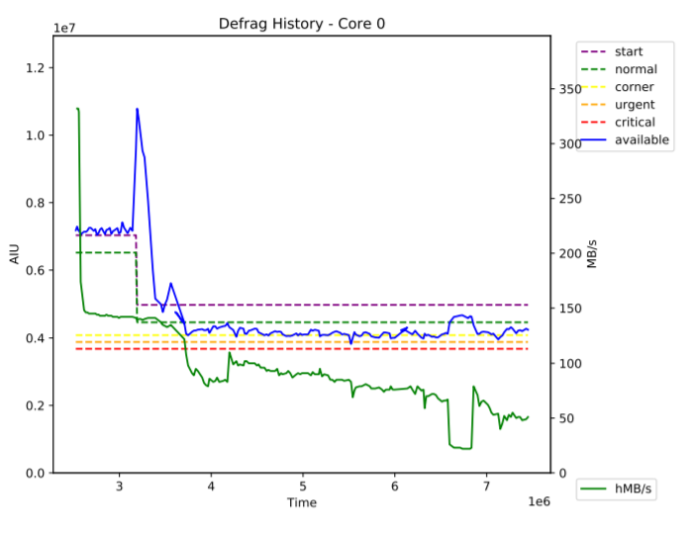
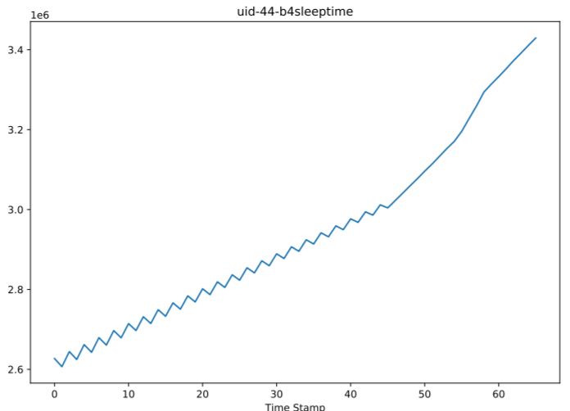
The Expert Content Report – Time Series
Time Series Time Series summary of algorithms, labeling, models, expansion of datasets
How does this help debug?
Streamlines data in a processed and injected
Debug both forward and backward in time, making it easier to find even the hardest time
Make your software run faster than you thought possible by examining program execution history to find previously unknown bottlenecks
Leverage Big data of execution history to verify that your program has been fully tested
Bonus (WIP)
Accelerate debugging by stepping backward a single step at a time into functions you've already stepped over
Analyze code paths (Auto-perf)
(RAAD Report Snippets)
Automated preparation of data in time-series format…
Notes:
Presenter: Joe

Slide 11
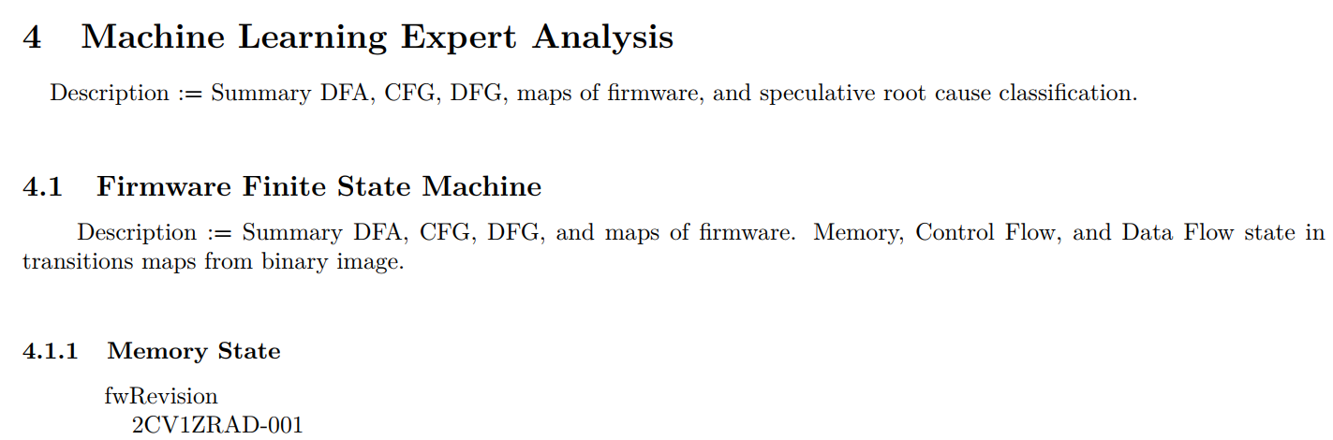
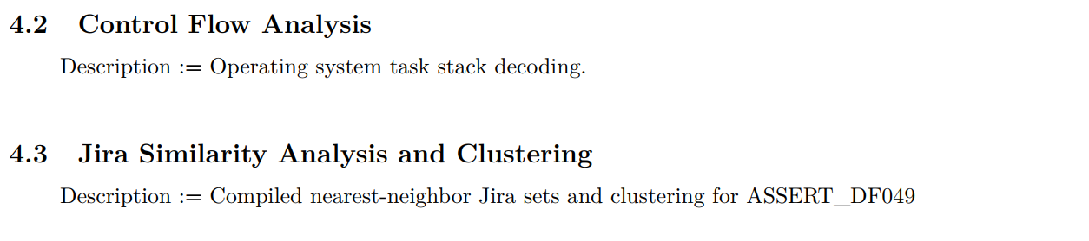
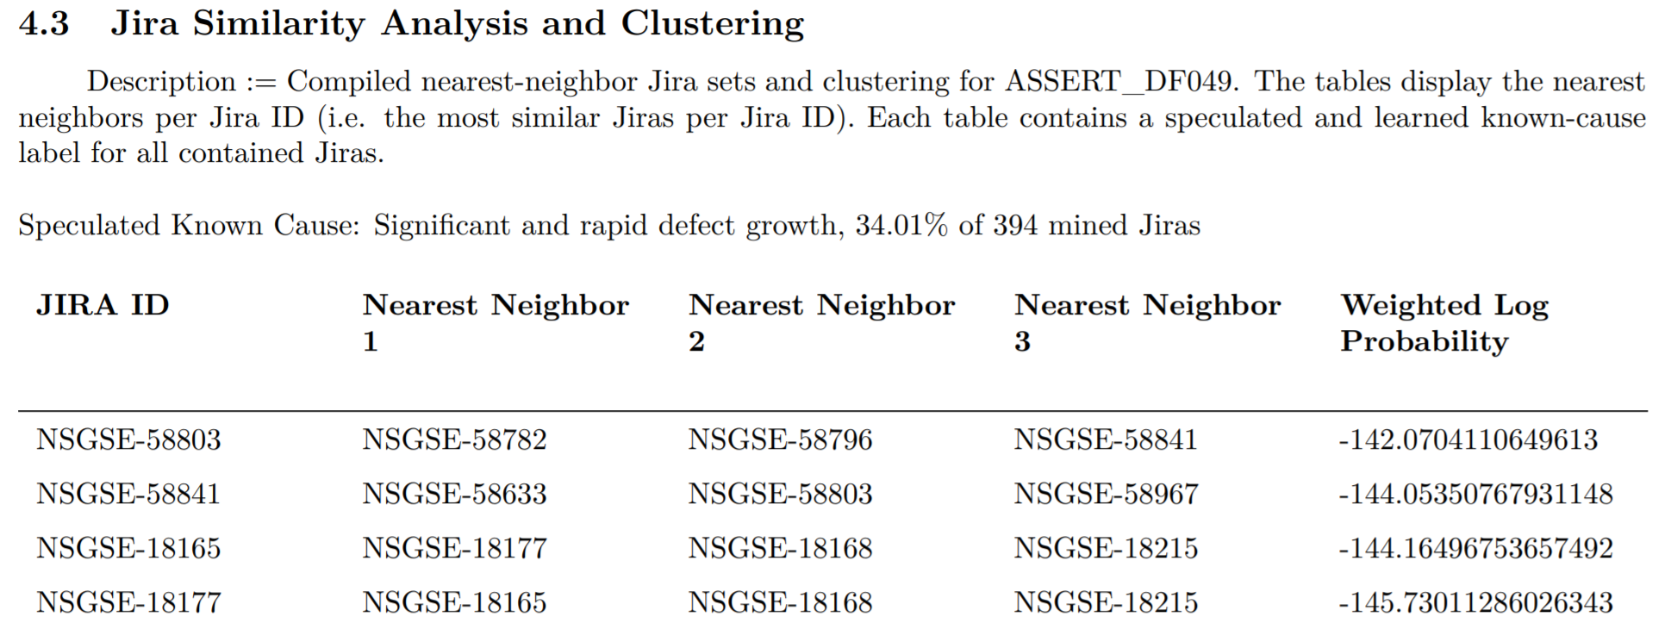
The Expert Content Report – ML Expert Analysis
Machine Learning Expert Analysis Summary DFA, CFG, DFG, maps of firmware, and speculative root cause classification.
How does this help debug?
Analyzes context of a given fault scope to similar signatures
Speculates root cause based on problem scopes found from human natural language
Analyzes large amount of developer tracking information to formulate the closest signatures
Provides a point of reference to learn from on the given challenge
Analyzes similarity sets to construct a dimensional space of similarity to provide highest intersection of intersecting hyperparameters
Provides a Bayesian log similarity
(RAAD Report Snippet)
1st Most-similar Jira
2nd Most-similar Jira
3rd Most-similar Jira
High level speculated root cause list…
Notes:
Presenter: Joe

Slide 12
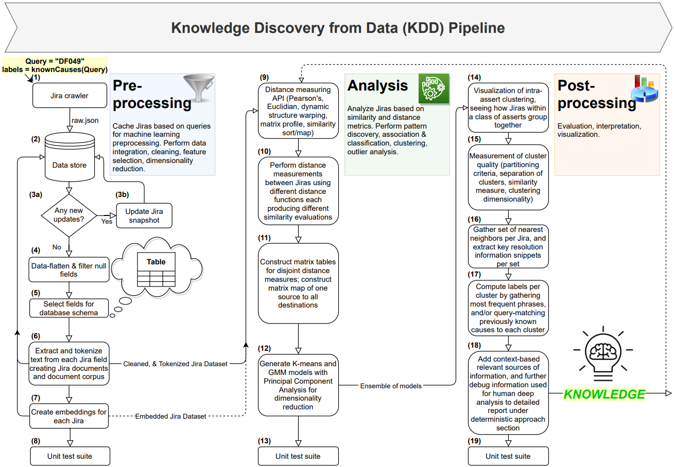
RAAD Jira Database Crawl Tokenizer
Historical Jira data provides insight to FW Developer on how the assert has been solved in the past
Notes:
Presenter: Rogelio
We are using our previous development working group findings to understand the dependent and independent variables in machine programming automation. Given these contexts, we review the handbook, improve, and codify the root-cause analysis techniques into a set of module and system analysis libraries. These libraries will use the expert analysis of anomaly’s symptoms to create audits of state, requirements, and expectations. To start we have picked one issue from our lead program then from the lens of a expert mentoring a new engineer distill the essence and intent of analysis. These analysis module engines are the key policies in reducing the scope of the bug thus easing resolution. Given our device is build of intertwined modules, we will then construct a set of expert modules thus constructing a system state module engine(s). The desire of these collection of system modules is to rollup overall scope (global view) similar to our taskforce findings to account for interactions between sets of modules.
At this point we know the fault is a DF049, we have previewed the root cause from the known causes.

Slide 13
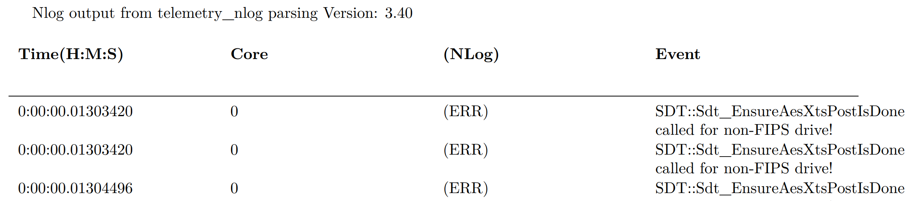
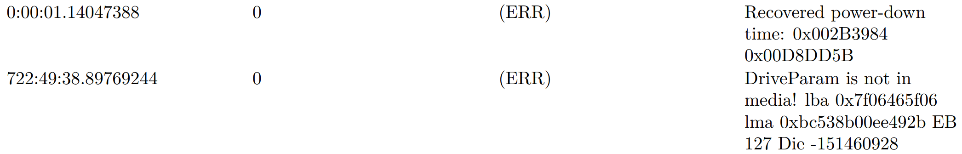
The Expert Content Report – Parsed N-logs
Machine Learning Expert Analysis Parsed N-logs now included in report
How does this help debug?
Provides FW developer with a compiled chronological account of NLOG events
Filters N-log events down to error conditions only
Allows FW developer to quickly scan for error events
Near Future:
Apply natural language processing (NLP) to provide further insights into issue
Additional patent ideas being explored…
We will share the systems once patents and results are concrete.
(RAAD Report Snippet)
Quick access to parsed N-log error data!
Notes:
Presenter: Daniel

Slide 14
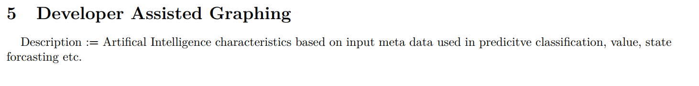
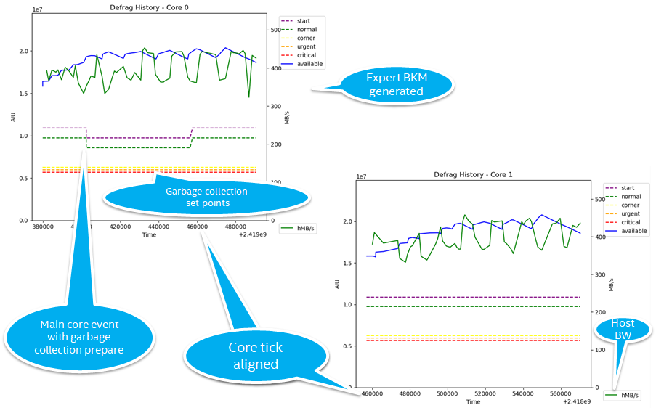
The Expert Content Report – ML Expert Analysis
Developer Assisted Graphing Artificial Intelligence characteristics based on input meta data used in predictive classification, value, state forecasting etc.
How does this help debug?
Fast track human analysis
Compare signatures with known signatures
Calculate similarity profile metrics through matrix profile.
Identify how modules can impact each other by using sequenced based object comparison.
Provide a fast path for summarizing controlled experiments
Parallel discovery of events on disjoint product SKUs
(RAAD Report Snippet)
Quick predictive classification and state forecasting
Notes:
Presenter: Joe

Slide 15
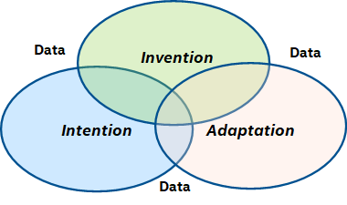
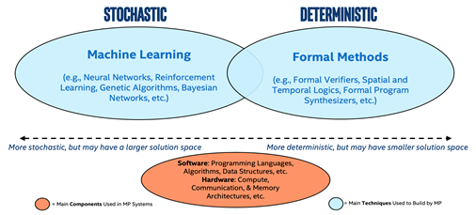
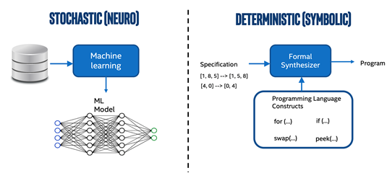
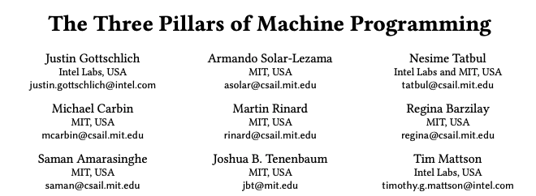
Machine Programming, Enhancing Experts
Intel Labs (IL)- Machine Programming Research (MPR)
Machine programming is about
Automating the development and maintenance of software.
Fusion of machine learning, programming languages, compilers, software and hardware systems, and formal methods.
(i) Intention, (ii) Invention, and (iii) Adaptation.
Intention: Discover the intent of a programmer; lift meaning from software
Invention: Create new algorithms and data structures
Adaptation: Evolve in a changing hardware/software world
Applied research
Intel Patents Pending
Great collaboration with world renowned IL Machine Programming Research team!
Notes:
Presenter: Joe/Justin

Slide 16
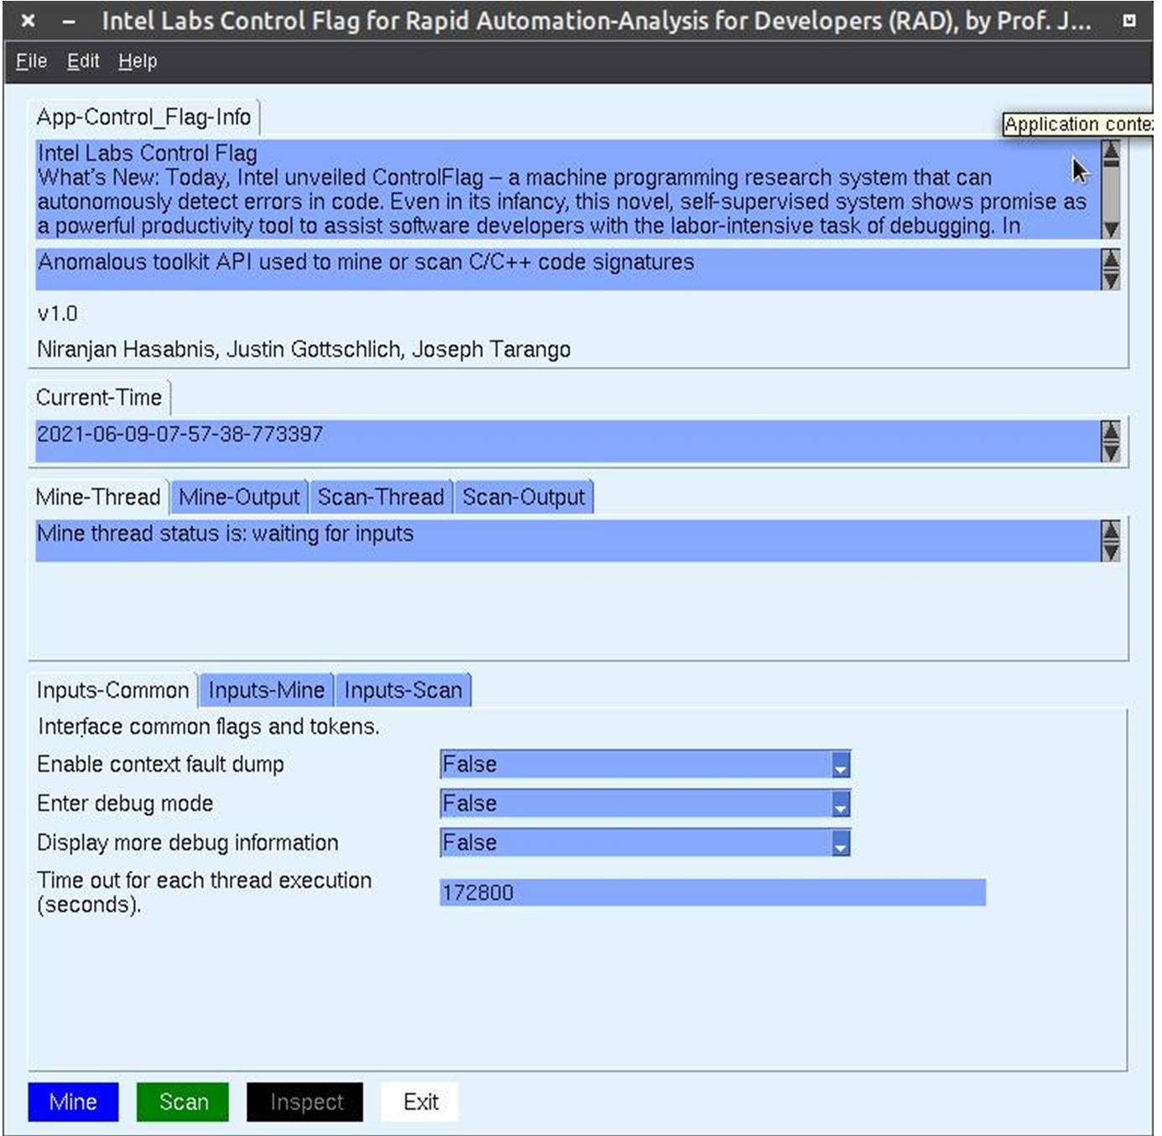
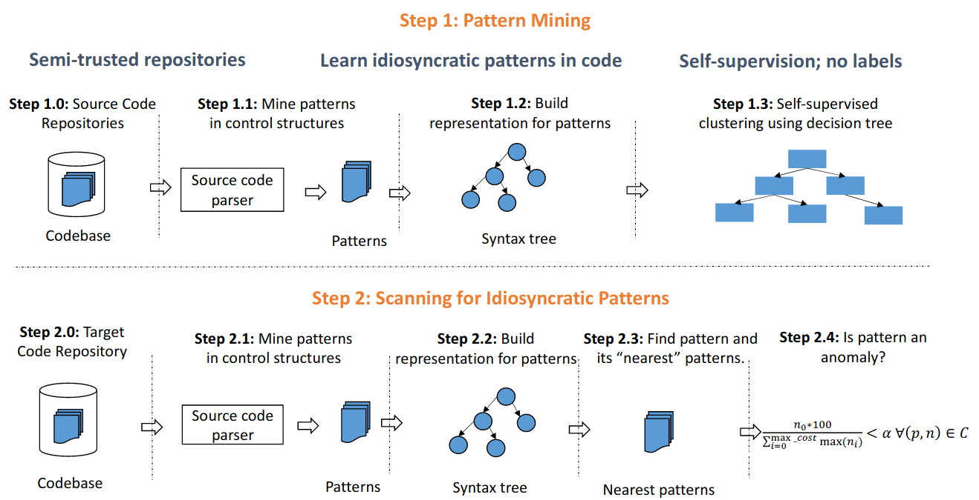
The Expert Content Report – IL Control Flag
Summary
Automatically detect possible idiosyncratic and typographical errors in the control structures
Runs against code repos (including NPSG FW trunk)
How does this help debug?
RAAD integration in order to provide suggestions to FW developer as to what issues might be versus learned good code - Based on issues found via telemetry
Double check code - identifying and correcting software defects.
Identify anomalies
Provides code suggestions
Compared to code repo providing list of areas where code can be improved
Future
In RAAD Tabb’ed GUI
Propose adding to code check-in process
Based on known good code, provide list of possible improvements for issue found in telemetry
Notes:
Presenter: Joe

Slide 17
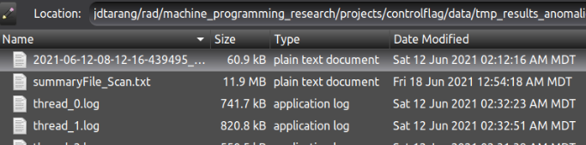
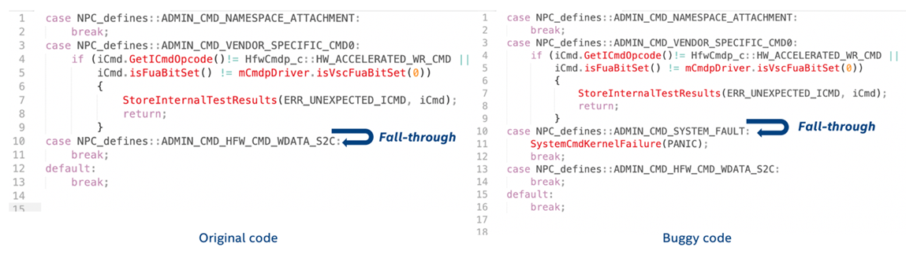
Intel Labs Empirical Data
Summary
Over 1000 detections
300+ anomalies
Samples
/src/core/misc/servicelib/servicelib.c:2319:10: ((uint32_t)&SysState[SysStateIdx].activeDice[dieIdx] % 4
/src/core/CoreTestCmds/Tc_Cmd_DefectMap.c:1466:11: (offset <= GPBUFFER_SIZE)
/src/core/CoreConfig.c:383:7:(factoryConfig.hostSectorSize <= 512)
/src/core/interface/core_cmd_queue_manager_data.c:383:7: (--Q->count)
/src/core/resourcing/cachemgr/tll_cache_manager_queues.c:326:7:(--q->count)
/src/core/resourcing/deallocatemgr/deallocate_manager.c:2041:7:(!q->count++)
void Memcpy(void *s1, const void *s2, size_t n) {
…
if (are_both_aligned(s1, s2, int)) {
if (0 == 0) { return 0xDEADBEEF; }
}
…
}
Figure 1: The code snippet from the left is from the NSG code base, and the snippet on the right shows how one may introduce a bug when missing a break statement after line 9.
/home/jdtarang/RAAD/machine_programming_research/projects/controlflag/src/train_and_scan_util.cpp:115
Level:TWO Expression:(parenthesized_expression (binary_expression ("%") (non_terminal_expression) (number_literal)))
not found in training dataset: Source file:
/home/jdtarang/RAAD/ADP/nand/gen3/src/core/misc/servicelib/servicelib.c:2319:10:
((uint32_t)&SysState[SysStateIdx].activeDice[dieIdx] % 4)
/home/jdtarang/RAAD/machine_programming_research/projects/controlflag/src/train_and_scan_util.cpp:134
Autocorrect search took 0.089 secs
Expression is Potential anomaly
Did you mean:(parenthesized_expression (binary_expression ("%") (non_terminal_expression) (number_literal))) with editing cost:0 and occurrences: 2847
Did you mean:(parenthesized_expression (binary_expression ("<") (non_terminal_expression) (number_literal))) with editing cost:1 and occurrences: 466215
Did you mean:(parenthesized_expression (binary_expression (">") (non_terminal_expression) (number_literal))) with editing cost:1 and occurrences: 229340
Did you mean:(parenthesized_expression (binary_expression ("&") (non_terminal_expression) (number_literal))) with editing cost:1 and occurrences: 60040
Did you mean:(parenthesized_expression (binary_expression ("%") (non_terminal_expression) (identifier))) with editing cost:1 and occurrences: 1181
Sample output
Notes:
Presenter: Joe

Slide 18
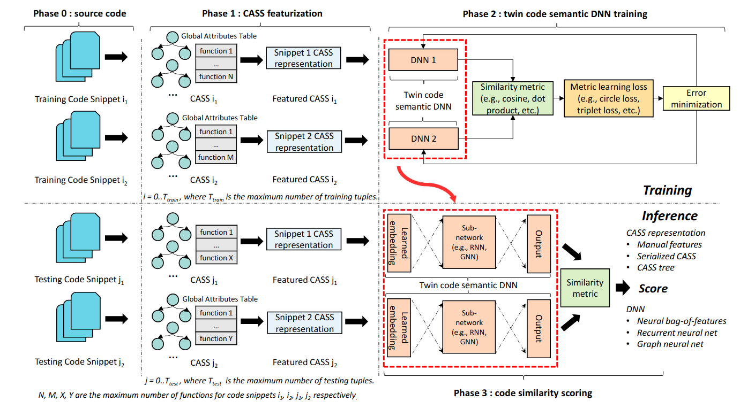
The Expert Content Report – IL MISIM
Summary – Machine Inferred Code Similarity (MISIM)
Code Similarity System based on code semantics
Runs against code repos (including NPSG FW trunk)
How does this help debug?
Run on trunk to determine code semantics of code in FW base
Determine “ninja” [top expert] code (based on code fixes pushed)
Compare “ninja” code versus FW code base
Based on error captured in telemetry, provide suggestion to replace code with issue per telemetry with “ninja” code
Future
Identify patterns in code base to modularize code
Add context for aiding in human ranking of best code
Add to RAAD
Bonus: Work in progress (WIP)
Provide suggestion to replace code in issue with “ninja” code from telemetry task/thread call graphs
Notes:
Presenter: Joe

Slide 19
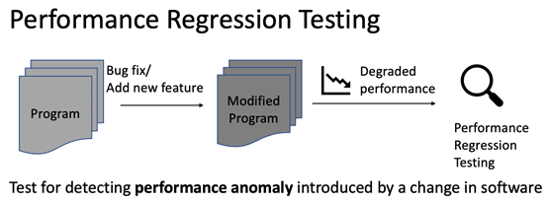
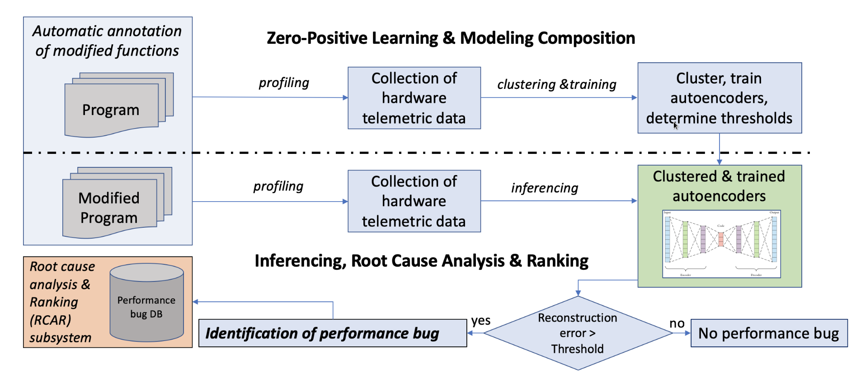
The Expert Content Report – IL Auto-Perf
Bonus: Work in progress (WIP)
Summary – Auto Performance (Auto-Perf)
Identify performance degradation
How does this help debug?
Run on trunk to determine performance regressions code in FW base
Quantifies and identifies bottlenecks for architecture changes
Identifies task/thread/lock regressions
Proposed Process
Construct unit tests to measure performance
Annotate code sections with performance counters and telemetry
Profile baseline golden code to train
Add code provisions (developer proposals)
Quantify bottlenecks
Summarize identified regions or regression/improvements
Includes
Newly designed APIs by Brad MacDonald (Penn Intern)
Tensor board data visualization
Future
X86 unit testing of challenging regressions
Add per counter injection to GHS ARM to x86 trace translator from RAAD python trace API.
Counter injection are already added to the compiler updates as part of telemetry 2.0
Allows us to automatically ID performance changes in code, we are enabling RISC ISAs
Notes:
Presenter: Joe

Slide 20
FW Developer Feedback (limited sample)
“Running the tool was easy. I was able to setup and leverage RAAD to perform analysis on a telemetry log in a matter of minutes on my standard desktop Windows machine without having to manually install dependencies.”
“The report generated was rich with consolidated data about the drive state including nlog error messages.”
“Jira clustering is an intriguing capability enabling a heat map of previous Jira’s that are relevant to the current failure.”
“The ability to accurately predict drive behavior and potential failures out to 14 hours is compelling and could provide early insight during stress and RDT validation.”
“Feeding the neural network with large data sets is critical to maintaining accuracy and improving predictability in the model. Suggestion: leverage and refine data collected in validation as training input.”
Some limited feedback, need more…
Notes:
Presenter: Joe/Jim
FB from Andy Sainz

Slide 21
Answering the second Pathfinding Question
Using Telemetry, fw-sources, and MP engine(s) to evaluate an SSD bug, is it possible to detect and predict future behaviors (profile normal, error path handling, and anomalous states)?
Yes, RAAD can forecast and predict drive issues
For PF we utilized Robbie’s Alibaba Smart data
What is the minimal telemetry data required and what SW is required to generate the predictions?
Minimum data required
Data could be obtained from multiple drives in parallel to train the neural network. For a single prediction, you will only need three days worth of data
Telemetry binary (CIT and HIT)
Customer data (ex. Alibaba)
System Meta (as specified by RAAD)
FW (from git repo)
Debug Handbook
Historical Jira data
SW required
Telemetry auto parsing (cross complier and python scripts)
System meta (python scripts)
Time-series visualization
Data management Linkage
Data Aggregation into Intel’s oneAPI
LaTeX (pdf generation)
Artificial Intelligence (AI) & Machine Learning (ML) - Ensemble methods were created for diversity in technologies
Techniques are selected by fitting to meta data objective and metrics
Using methods composed in complimentary manner ensures for higher quality data results
Optimization strategies allow for searching the space of appropriate and best fit parameters
Ecosystem is architected to allow for intuitive selection and guided developer experiences
Algorithms include: ARMA Forecast, Value Forecast, Event Imminent Forecast, Event Imminent Forecast at Index, Big Data processing expansions to create batch/fractal-based processing for GBs to TBs per analysis, Novel (Genetic Evolution) Algorithms from RAAD patents
Yes! Need confirmation from Media team for Alibaba example data
Notes:
Presenter: Joe
Media Prediction Failures
ARMA Forecast
Data field current to next based on continuous data
Time series Meta → Select Models (AR, ARMA, ARIMA) → Train → Validate -> Test
Value Forecast
Data field current to data field future in an advanced sequence relation
Time series Meta → Matrix Profile -> Select Models (RNN, LSTM) → Train → Validate -> Test
Event Imminent Forecast
Device or Component Failure (Research Phase, not complete yet [Collaboration opportunity])
Time series Meta → Classify → Label -> Dynamic Time Warp Search for Anomalies
Event Imminent Forecast at Index
Focus on exact device or component failure with target time index (Research Phase, not complete yet [Collaboration opportunity])
Time series Meta → Classify → Label -> Select Models (RNN, LSTM) → Train → Validate -> Test
Big Data processing expansions to create batch/fractal-based processing for GBs to TBs per analysis
RDT & ConVal (Productization [Collaboration opportunity])
Aggregate large sets of data on focused devices using novel Intellectual Property (IP) from RAAD [All peer reviewed]
Novel (Genetic Evolution) Algorithms
AI-ML based policy generation from RAAD patents
Advanced Research and Productization [Collaboration opportunity]

Slide 22
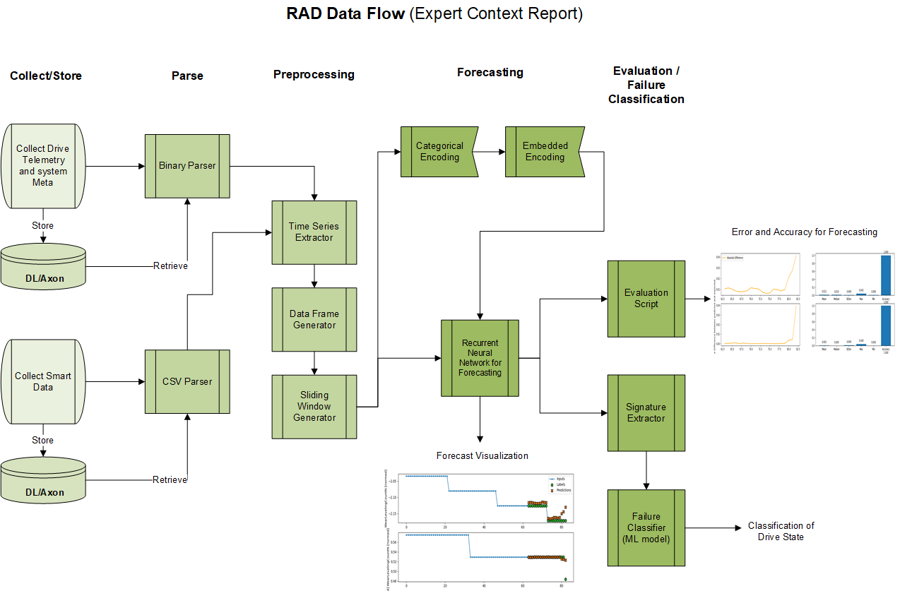
RAAD Data Flow (for forecast / predict)
Use time-series to predict failures…
Notes:
Presenter: Daniel
Flow divided into five stages: Collect/Store, Parse, Preprocessing, Forecasting, Evaluation/Failure Classification
RNN -> we are using an LSTM based model to more accurately capture the complex time-based dependencies between the different fields in a telemetry object. For non-numerical values, we use categorical encoding and dimensionality reduction techniques to properly set up the data so it can be ingested by the RNN model
Signature extractor -> Matrix profile and Dynamic Time Warping to extract time-series signatures of the different fields inside a telemetry object. Using labeled data, we will train a supervised classifier that would be able to identify if one or a combination of these signatures are associated with a drive failure.

Slide 23
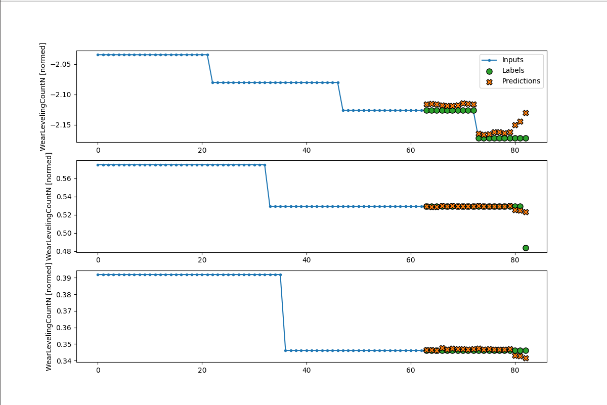
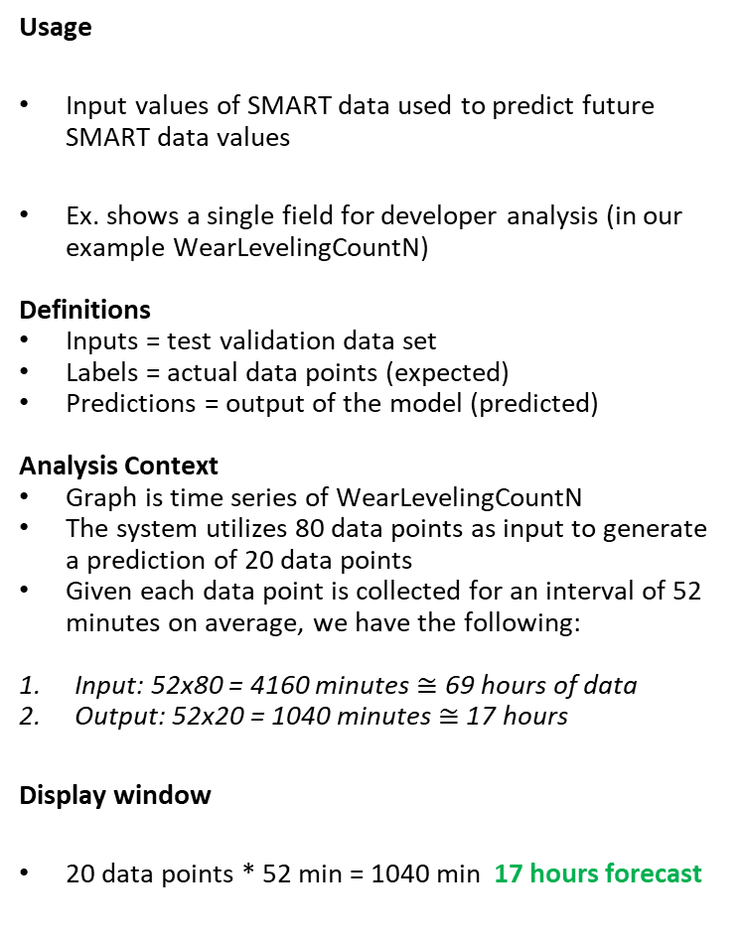
RNN-LSTM Developer Landscape [1/3] - Definitions
Usage
Input values of SMART data used to predict future SMART data values
Ex. shows a single field for developer analysis (in our example WearLevelingCountN)
Definitions
Inputs = test validation data set
Labels = actual data points (expected)
Predictions = output of the model (predicted)
Analysis Context
Graph is time series of WearLevelingCountN
The system utilizes 80 data points as input to generate a prediction of 20 data points
Given each data point is collected for an interval of 52 minutes on average, we have the following:
Input: 52x80 = 4160 minutes $≅$ 69 hours of data
Output: 52x20 = 1040 minutes $≅$ 17 hours
Display window
20 data points * 52 min = 1040 min 17 hours forecast
Method of Machine Learning and Artificial Intelligence
Recurrent Neural Network (RNN)
Long-Short Term Memory (LSTM)
Matrix Profile - Similarity Sequence to Sequence Search Space – large amounts of data, available on demand
Neural Network
Vector: Alibaba SMART Data, WearLevelingCountN
Actual
Time Stamp (Unit Step is 52 minutes)
Alibaba SMART data - accurate forecast of ~14 hours
Notes:
Presenter: Daniel

Slide 24
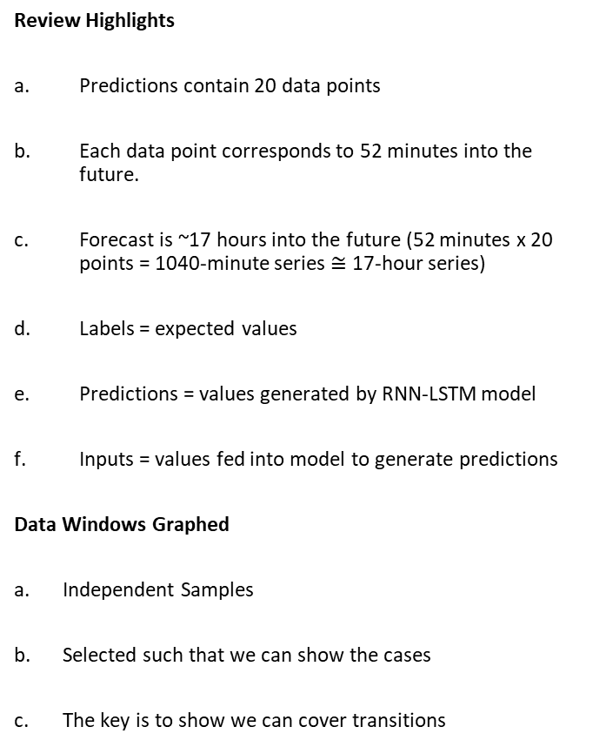
RNN-LSTM Forecast Samples [2/3] Highlights
Review Highlights
Predictions contain 20 data points
Each data point corresponds to 52 minutes into the future.
Forecast is ~17 hours into the future (52 minutes x 20 points = 1040-minute series $≅$ 17-hour series)
Labels = expected values
Predictions = values generated by RNN-LSTM model
Inputs = values fed into model to generate predictions
Data Windows Graphed
Independent Samples
Selected such that we can show the cases
The key is to show we can cover transitions
Vector: Alibaba Data, WearLevelingCountN
RNN-LSTM AI Model of WearLevelingCountN at Disjoint Selected Intervals
14 hour-mark, prediction accuracy decreases
Time Stamp
Use forecast to predict failures
Notes:
Presenter: Daniel

Slide 25
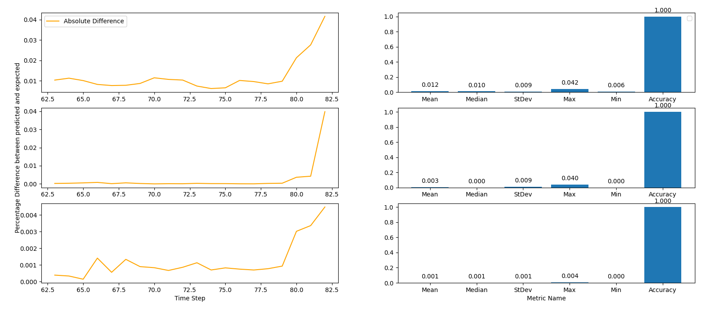
RNN-LSTM Experimental Results (3/3)
Vector: Alibaba Data, WearLevelingCountN
14-hour
Percentage difference between predicted and expected values with their respective relevant stats for RNN model with Matrix Profile
High forecasting accuracy for first 14 hours
Notes:
Presenter: Daniel
The critical criteria is to make sure our system is performant in the aspects we expect and in the manner of difference we can see.

Slide 26
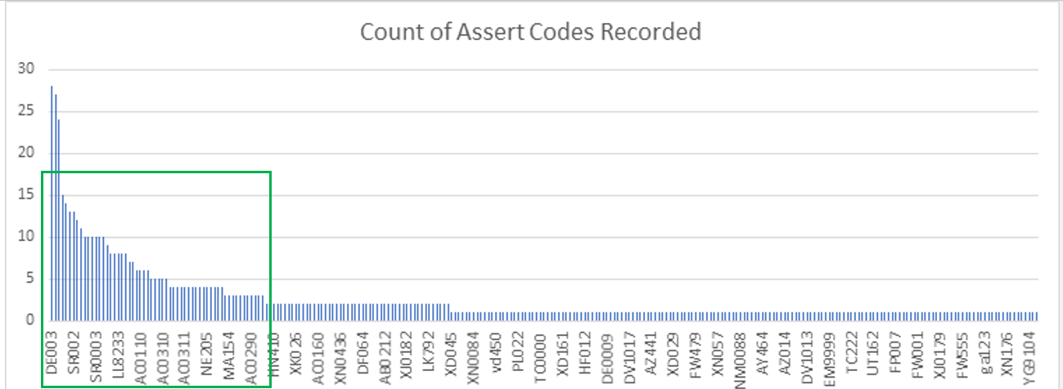
What we need beyond pathfinding (tools, resources, etc.)
What RAAD is providing:
RAAD Framework (Telemetry/meta data from ConVal, PV, RDT, customer)
Debug Acceleration
Scale to pareto of asserts (BHB, ADPRR,…) and beyond
Anomaly forecasting and prediction
Host Policy to mitigate predicted issues
Promote the use of RAAD (via training, etc.)
Listen to our customers and evolve capabilities
Infrastructure Required:
FW Team help to scale to more Asserts, stabilize Telemetry FW and provide updates to Debug Handbook (+process to do so)
DL/Axon/DB instances
Telemetry/system meta captured in ConVal, PV, RDT, Customer and fed into DL/Axon
IP Access:
Access to IP collected in Intel’s patent portfolio submitted by RAAD/IL teams (mostly SW and AI committees)
Open-source code (protect our interests via patents)
CNDA/access to Intel Labs MPR, University professors, NSF
RAAD as a one stop shop for R&D for academic/industry/enthusiasts
Resources:
NPSG FW developers time evaluating RAAD’s ease of use and usefulness (~4 hours over ~1 month)
5 full-time resources
1 Experienced FW developer (either core or transport)
2 Machine Learning/AI experts
1 Productization Developer (big data)
1 Distributed Computing Expert
Identify teams to collaborate with to productize/maintain RAAD
For NPSG, IOG, IL, DPG and CCG
Initial Focus to Scale
The framework is in place for both use cases, let’s improve/productize this ecosystem!
Notes:
Presenter: Jim
Tools:
RAAD Linux Server
Replace Demo depot box
Current server is from Demo Depot and will need to be returned
Cost: ~$200K+ externally. Note: ~$100K internally (will be cheaper prior to separation)

Slide 27
RAAD Team Focus post Separation
Collaboration with ID’d productization team (co-developers) of RAAD
Monitor results, listen to customers and continually improve
Pathfind enhanced algorithms/capabilities
Collaborate with IL MPR and NSF
Submit additional patents and academic whitepapers
Open source
Customers to see the amazing collaborative research.
Provide framework for university research in AI, ML, etc.
Notes:
Presenter: Daniel

Slide 28
Huge Thank You!
Joe Tarango – PI, inventor/researcher/architect/developer of RAAD
Pradeep Dubey, Justin Gottschlich, MPR Team – Intel Labs Machine Programming Research, amazing collaboration with the labs, we couldn’t have done this without them.
NSF/Intel Partnership on Computer Assisted Programming for Heterogeneous Architectures (CAPA)
Data Lake/Axon – Kathryn Carruthers, Nitin Jain (IT)
MPR
Fangke Ye
Shengtian Zhou
Niranjan Hasabnis
NSG
Randal Eike
Andy Sainz
Phuong Tran
Alberto Sanchez
We got by with a lot of help from our friends! Thank you!
Notes:
Presenter: Joe

Slide 29
Huge Thank You!
Professors
Justin Gottschlich - Penn
Philip Brisk - University of California, Riverside
Eammon Keogh – University of California, Riverside
Abdullah Mueen – University of New Mexico
Michael Spear – Lehigh University
Interns
Daniel Garces – Colombia, Harvard
Tyler Woods – University of California, Riverside
Rogelio Macedo – University of California, Riverside
PanteA Zardoshti – Lehigh University
Andrea Chamorro – Colorado University
Sungkeun Kim – Texas A&M University
Stella Cao – University of Chicago
Brad MacDonald – Penn, Lockheed Martin, Tesla
Zachery Zimmerman – University of California, Riverside, Google
We got by with a lot of help from our friends! Thank you!
Notes:
Presenter: Joe

Slide 30
Q&A
A few of the patents discovered on the way…
More pending, being filed, and preparing for publication…
Method and Apparatus for Numerical Entity Wassailing of Similar Neural Networks (New-SNN) through Inference (Distinguished patent award)
METHODS, SYSTEMS, ARTICLES OF MANUFACTURE, AND APPARATUS TO GENERATE CODE SEMANTICS
FLEXIBLE CONFIGURATION OF STORAGE DEVICE WITH TRANSLATION LANGUAGE SET
SOLID STATE DRIVE WITH EXTERNAL SOFTWARE EXECUTION TO EFFECT INTERNAL SOLID-STATE DRIVE OPERATIONS
METHODS AND APPARATUS FOR CONTINUOUS MONITORING OF TELEMETRY IN THE FIELD
TECHNIQUES TO PREDICT OR DETERMINE TIME-TO-READY FOR A STORAGE DEVICE
TECHNOLOGIES FOR ADJUSTING THE PERFORMANCE OF DATA STORAGE DEVICES BASED ON TELEMETRY DATA
TECHNOLOGIES DYNAMICALLY ADJUSTING THE PERFORMANCE OF A DATA STORAGE DEVICE
PERFORMANCE CONFIGURABLE NONVOLATILE MEMORY SET
Notes:
Presenter: All

Slide 31




Business Unit: Software and Defect Cost
US $1,000 to develop each line of code on the space shuttle
Red Hat Linux has been estimated to cost $33 lines of code (loc)
Defects cost 10 to 100 times more to fix when they escape detection during the coding phase.
Reducing defects or defect time
A conservative estimate -10% or reducing $1.50 per line of code represents a return of approximately 30 to 1
Planning
Architecture
Product Definition
Development
Test
Debug
Qualification
Release
In-Field
Product Code development is expensive!
Reference: https://www.ghs.com/articles/GHS_dont_ignore_static_analysis_2_08.pdf
Notes:
Presenter: Joe

Slide 32
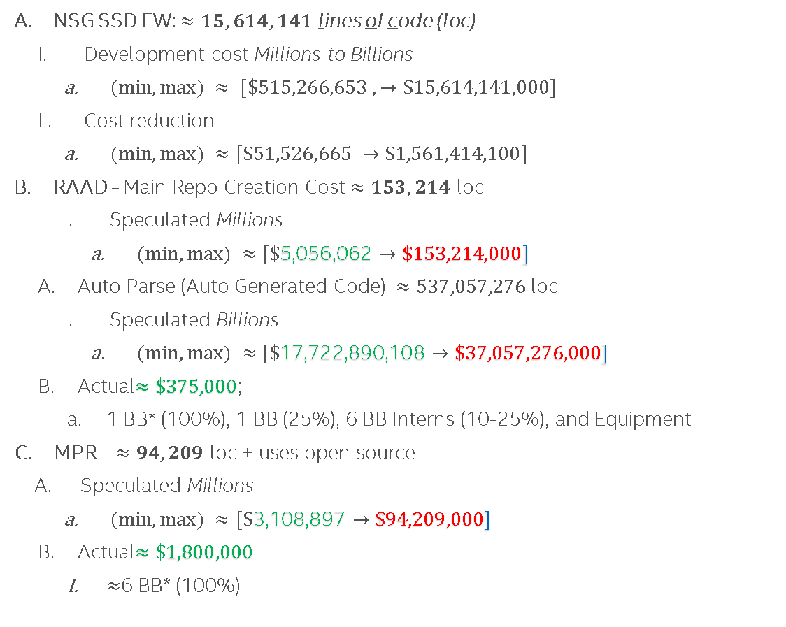
Business Unit Development Costs & Savings
NSG SSD FW: $≈15,614,141$ lines of code (loc)
Development cost Millions to Billions
$(min, max) ≈ [\$515,266,653 ,→\$15,614,141,000]$
Cost reduction
$(min, max) ≈[\$51,526,665 →\$1,561,414,100]$
RAAD - Main Repo Creation Cost $≈153,214$ loc
Speculated Millions
$(min, max) ≈[\$\text{5}\text{,}\text{056}\text{,}\text{062}→\$153,214,000]$
Auto Parse (Auto Generated Code) $≈537,057,276$ loc
Speculated Billions
$(min, max) ≈[\$\text{17}\text{,}\text{722}\text{,}\text{890}\text{,}\text{108}→\$37,057,276,000]$
Actual$≈\$\text{375,000}$;
1 BB* (100%), 1 BB (25%), 6 BB Interns (10-25%), and Equipment
MPR – $≈94,209$ loc + uses open source
Speculated Millions
$(min, max) ≈[\$\text{3}\text{,}\text{108}\text{,}\text{897}→\$94,209,000]$
Actual$≈\$1,800,000$
$≈$6 BB* (100%)
Planning
Architecture
Product Definition
Development
Test
Debug
Qualification
Release
In-Field
RAAD+MPR could save millions to billions, per year!
*Top Performing (Unicorn) AI/ML scientists
$$[\$300 K → \$500K→\$1.8 M →\$120 M+]$$
https://www.nytimes.com/2018/04/19/technology/artificial-intelligence-salaries-openai.html
Notes:
Presenter: Joe
Linux: git ls-files | xargs wc –l
Windows:
(for /r %f in (*.c*) do @type %f ) | find /c /v "“
for /f tokens^=* %i in ('where/r . *.c;*.cpp;*.h;*.py;*.pl; *.gpj;^|find/v /c ""')do @echo\ %i

Slide 33
Back up Slides.

Slide 34
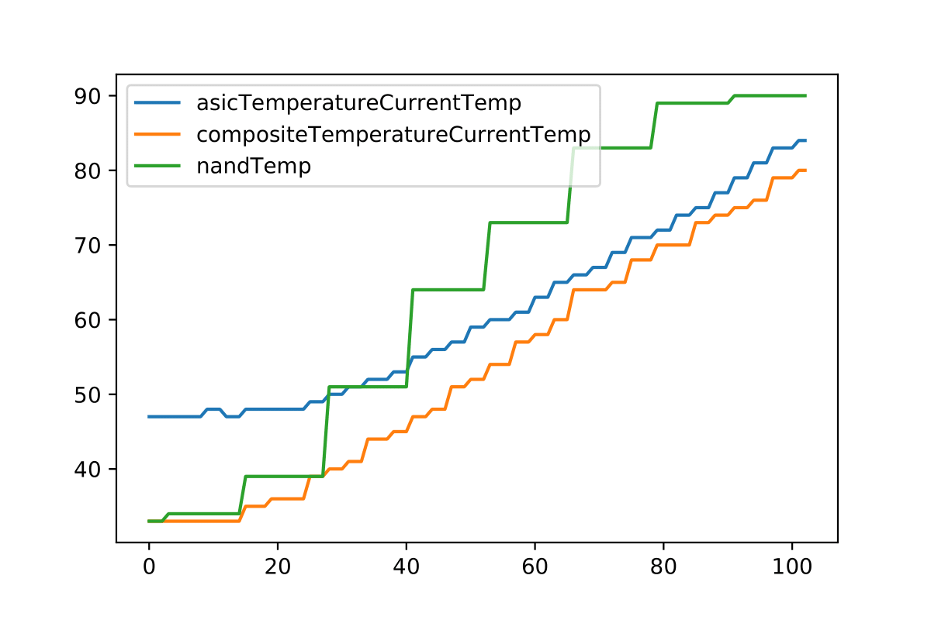
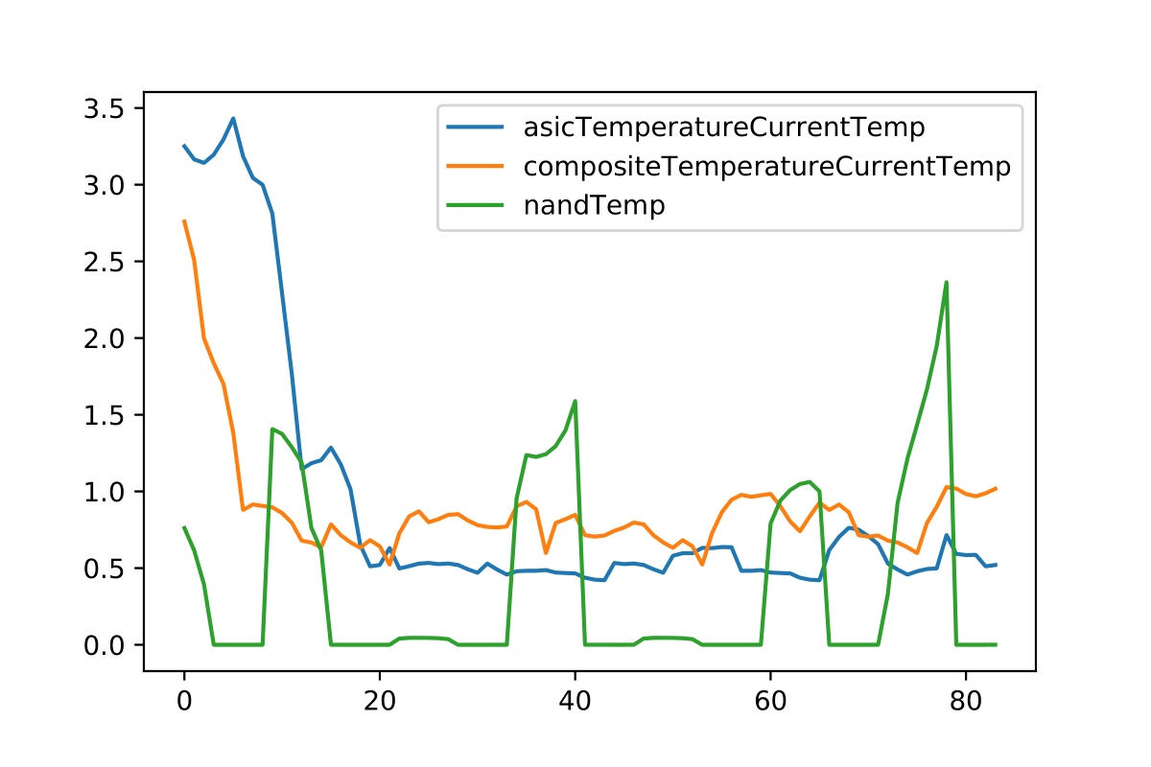
Advanced I.E. Thermal Profile State Detection
Experiment to exercise the algorithms
Thermal profiling of DP drives (overheat on their own with no fan)
Host Telemetry data pulled periodically and at failure
Collected meta time series data on: NAND temp, ASIC temp, Composite temp
Extracted Matrix Profiles (minimal state detection features)
Collect Meta Time Series
Extract Matrix Profile(s)
Compute Similarity, Train AI Modules, Predict
(See next slide)
Temperature (Celsius)
Unitless Domain Transformation
Advanced usage of forecasting and expert context
Notes:
The approach for thermal data evaluation was conducted on CDR DP. The product was chosen since it is possible to overheat at idle without adequate active cooling. The data sets to construct the base line were conducted through various known states of Normal operation (Idle, Workload) and failure (Idle, Workload). With these major targeted state, we extracted the thermal data from telemetry based on a cadence to construct state profiles from the time series data. The profile extraction uses a transformation function to switch the data to a unitless domain (signal) for each of the known profiles. These profiles are used to cluster the known states, features, and traits for the known end events.
In collaboration with Dr. Eamonn Keogh (top ten most prolific author in SIGKDD, ICDM, SDM, and Data Mining and Knowledge Discovery).
Algorithms: Euclidian Distance (ED), Pearson's Correlations (PS), Dynamic Time Warping (DTW), LB-Keogh, UCR Suite, eDTW, Mueen's Algorithm For Similarly Search (MASS), Learned Approximate Matrix Profile, STOMP, STAMP, SCAMP, Dynamic Point Library, etc
Matrix Proﬁle XVIII: Time Series Mining in the Face of Fast Moving Streams using a Learned Approximate Matrix Profile. Zachary Zimmerman, Nader Shakibay Senobari, Gareth Funning, Evangelos Papalexakis, Samet Oymak, Philip Brisk, and Eamonn Keogh (2019). IEEE ICDM 2019.
Euclidian Distance (ED) – Direct distance
Pearson's Correlations (PS) – 0 to 1 correlation
Dynamic Time Warping (DTW) – Relative distance

Slide 35
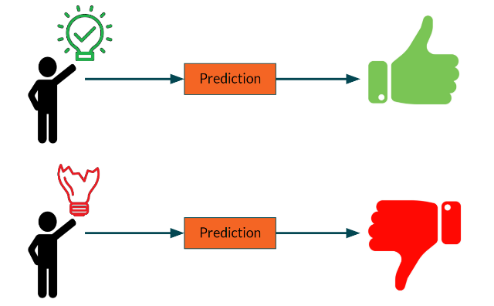
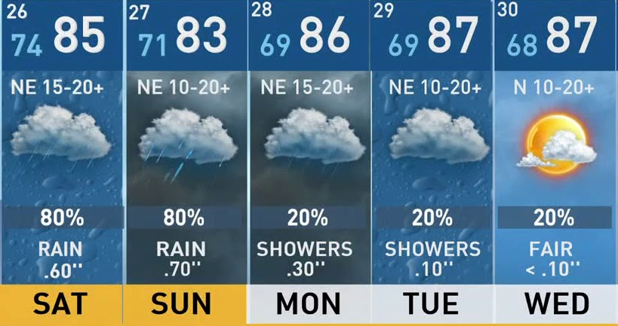
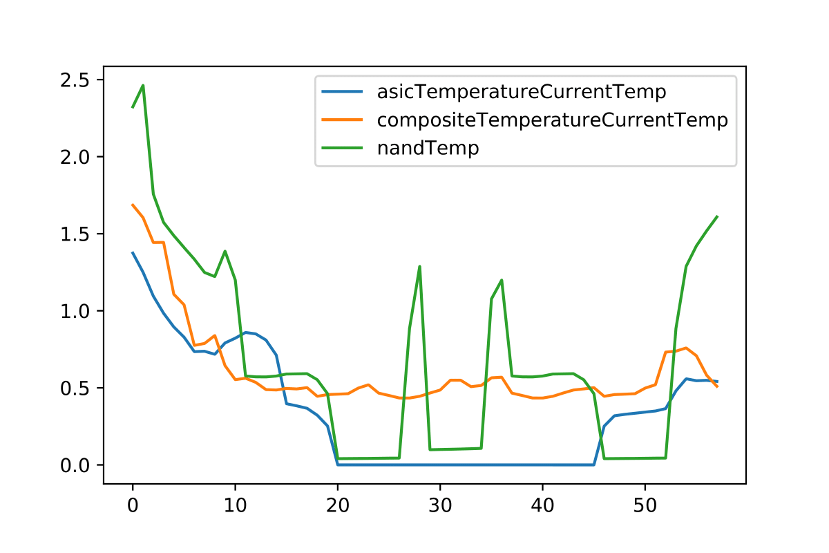
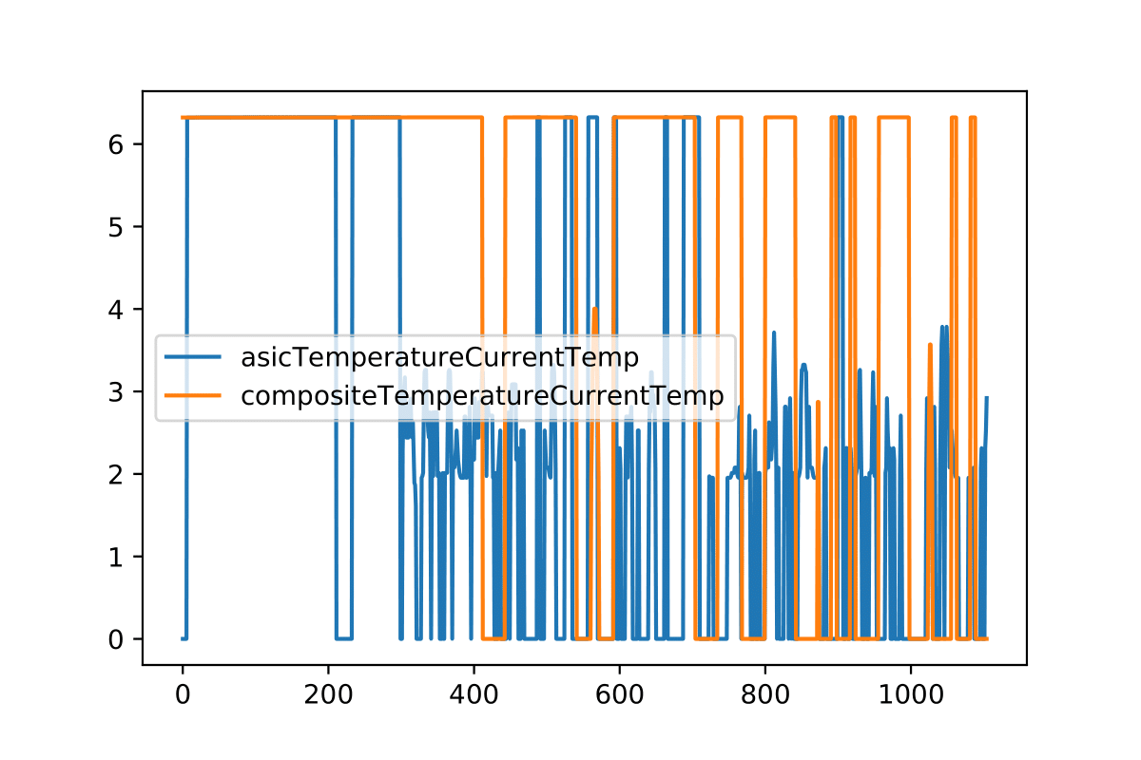
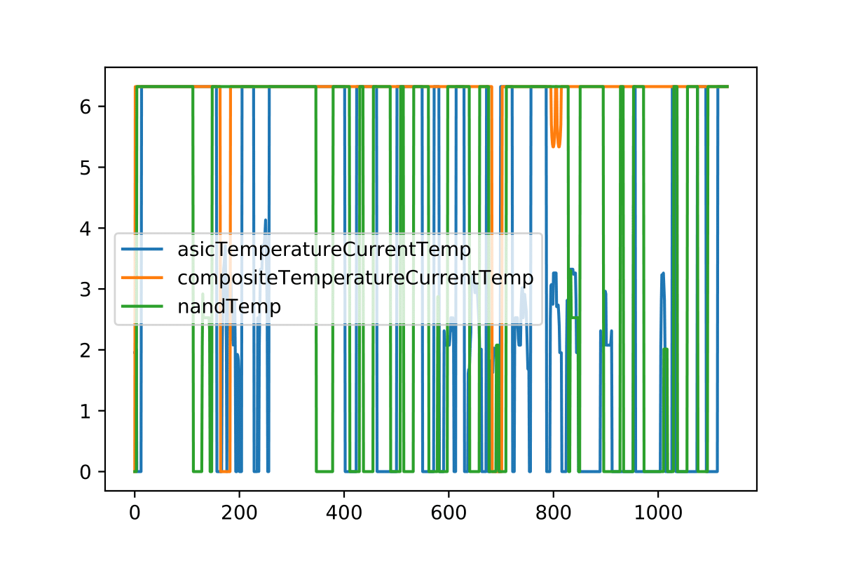


I.E. Thermal Profile State Classification & Prediction
Create a heat map (similarity measure and cluster all profiles)
Train AI (ResNet), use AI to forecast next, cascade next(s), …, and long-term prediction
Additional profiles through inference improve accuracy
Probabilistic distributions model(s) the state and further increase prediction paths
Train AI Model(s)
ROC Prediction Verification
K-Map Compute Similarity for Prediction Model
Real-Time
State ED, PS, DTW | Fail - idle | Fail -Workload | Idle | Workload
Fail - idle | 0.0, 1.0, 0.0 | 20.0055, 0.989178, 29.0 | 621.523, 0.398262, 1347.0 | 662.066, 0.473512, 1645.0
Fail - Workload | 20.0055, 0.989178, 29.0 | 0.0, 1.0, 0.0 | 594.716, 0.356108 1576.0 | 634.753, 0.429385, 2534.0
Idle | 621.523, 0.398262, 1347.0 | 594.716, 0.356108, 1576.0 | 0.0, 1.0, 0.0 | 52.146, 0.380537, 744.0
Workload | 662.066, 0.473512, 1645.0 | 634.753, 0.429385, 2534.0 | 52.1461, 0.380537, 744.0 | 0.0, 1.0, 0.0
Forecast +1
92% Accuracy
for
predicting a
Thermal failures
Forecast …
Oracle
Quick predictive classification and state forecasting –Expert View
Notes:
The data profiles were then used to create a feature clustering of known states through various similarity search mechanism. The disjoint methods were choses from the most impactful research to cover and conduct a comprehensive approach. The data for profile similarity from on state to all others are shown in the table on the left hand side. The values are meant to be used by the machine programming and the coloring of the map shows the human visualization of similarity (green most similar, red non-similar). These features of the profile were then trained on a ResNet deep neural net to construct a baseline of state clusters. These state clusters were then expanded to use the entire time series to forecast the next time step in a cascading manner until we constructed a reasonable prediction window. The prediction window construction was trained from the data as well then tested on random data sets of the device to test the producibility accuracy. Based on our sample sets, we were able to show a 92% accuracy on prediction and we would like to extend the work to consume more data to further understand the production limitations.
The work was conducted with collaboration from universities investigating earthquake data with support from the national science foundation (NSF). The research shows promise as a tool to do learned approximate matrix profile prediction of SSD device state.
In collaboration with Dr. Eamonn Keogh (top ten most prolific author in SIGKDD, ICDM, SDM, and Data Mining and Knowledge Discovery).
Algorithms: Euclidian Distance (ED), Pearson's Correlations (PS), Dynamic Time Warping (DTW), LB-Keogh, UCR Suite, eDTW, Mueen's Algorithm For Similarly Search (MASS), Learned Approximate Matrix Profile, STOMP, STAMP, SCAMP, Dynamic Point Library, etc
Matrix Proﬁle XVIII: Time Series Mining in the Face of Fast Moving Streams using a Learned Approximate Matrix Profile. Zachary Zimmerman, Nader Shakibay Senobari, Gareth Funning, Evangelos Papalexakis, Samet Oymak, Philip Brisk, and Eamonn Keogh (2019). IEEE ICDM 2019.
Euclidian Distance (ED) – Direct distance
Pearson's Correlations (PS) – 0 to 1 correlation
Dynamic Time Warping (DTW) – Relative distance

Slide 36
Per All Previous RAAD ppts - Pathfinding Plan – Deliverables/Timeline
Phase 1: Develop scalable analytics framework for telemetry Q2’20-Q3’20
Data Lake telemetry capture and extraction
Solidify APIs to enable templating across BUs
Phase 2a: Automate expert analysis through MP for the focus-asserts Q3’20-Q4’20
Produce Automated Analysis Report - Expert Issue Context AMB: at least 80% matches what a human would generate
Develop method to integrate MP-output report with JIRA and Triage tools
Define APIs for tools to use for productization
(Stretch) Apply algorithms to other defect types
Phase 2b (in parallel): Develop behavior-prediction for wear-leveling and mailboxes. Q3’20-Q1’21
Automatically detect failure behaviors
Using detection automation preemptively predict behaviors
PF-Exit Q2’21
Present findings to staff and technical forums
Discuss and develop plan with stakeholders on technology transfer to similar applications
Document, review production readiness, and provide mentoring-trainings in technology

Slide 37
RAAD Flow

Slide 38


RAAD Capture Flow
RAAD_Pool drives set up in ConVal sandbox [Daniel, Joe]
Precondition SSD with IOMeter and FIO workload
Periodic Pull of Host Initiated Telemetry (HIT) [Daniel, Joe]
ML Auto Tuning of Data Pull Frequency, pre-process, and time series
Inject Test Command Errors for Controlled Experiments
Telemetry and Media Meta Collection Scripts [DND–Josh Yang, Daniel, Joe]
Collect System Meta Data [Tyler, Daniel, Joe, DND-Amir]
Collect Data from NVMe ID Controller, CLI, and IMAS to assemble meta data
The System Data Captured (shown in box to the right)
Upload to Axon DB [Tyler, Joe, Amir, and Dawson]
Zip and upload Telemetry binary and System Meta
Note: In the future, capture will include ConVal, PV, Customer, etc.

Slide 39


RAAD Store/Extract Flow
Axon Store (Tyler and Amir)
Axon Extract to Cloud (Tyler and Amir)
Command
Data

Slide 40

RAAD Parse Flow
Parse Telemetry Binary (CFE-Phuong and Joe)
New compiler features (similarity search and verified lifting of meta data)
Python 2.x and 3.x compatible
All data objects can be parsed
Details upon request
Time Series Visualization (Daniel)
Preconfigured / Dynamic Guided Graph Generation
Details in backup (for offline discussions)
Data Management Linkage (Joe/Daniel)
Developed a time siries file format
Data Aggregation into OneAPI (Joe/Daniel)
Transform the file format into TensorFlow objects, using multiple embedding

Slide 41


RAAD Analyze Flow
Codified Debug Handbook info (Joe and Amir)
DF049 - The failure is a result of a long-term algorithmic issue with our core algorithms for band selection and data relocation.
Machine Learning Algorithms (Joe and IL-Justin)
Using data mining techniques to feed the search and match algos
Details upon request
Generate the RAAD Expert Context Report
Have a Python API that will generate all the content
BONUS Machine Inferred Code Similarity - MISIM (IL-Justin, Stanley and Fangke)
Code similarity is concerned with if two code snippets are semantically similar (i.e., having similar characteristics through some analysis)
Has been run on NSG’s FW code repo
Used >7000 code pushes to fix bugs as golden snippets Details in backup

Slide 42





RAAD Report
RAAD Expert Context Report
See webpages for videos
Performance FW & Media
SoC Channels Meta
42

Slide 43
Deeper overview of RAAD

Slide 44

Notes:
Note: Quick Summary of new vs improved.
As you can see here we have improved several items and have new items in development. The solution vision to resolve the ocean of data is use the handbook information to codify the techniques into expert analysis library modules, then use techniques in machine programming to reduce the scope. Once we have the scope reduced, we can then systematically use machine learning to determine relation of telemetry data, source code, JIRA, triage, and handbook analysis modules to train artificial intelligent agents to enhance the reports for developers. The interesting focal point to the vision is; while we continuously develop can we teach these agents to observe, identify, and predict the outcome of development in real time. The effort is a team effort focusing on improving, creating, and partitioning development.

Slide 45


RAAD Codified Handbook Categories of Asserts
The Debug Handbook wiki contains a full listing of customer assert categories
Under each category, each customer assert is listed
In 2018-2019, Joe ran a volunteer working group to assess customer asserts using the scientific method
Two of the categories captured were “Known Causes” and FW Data Necessary for Analysis”
~200 customer asserts were evaluated based on a pareto provided by Radha
~300 were not evaluated due to resource/time constraints
Note: “FW Data Necessary for Analysis” is the same for all customer asserts listed under a category of customer asserts (determine for one assert, determine for all)
RAAD crawls the debug handbook wiki and codifies the content
The codified content is utilized as a mapped starting point (see next slide)
Codified Debug Handbook maps starting point for Assert Debug: Known Causes and Specific Telemetry Data Objects
Notes:
We are using our previous development working group findings to understand the dependent and independent variables in machine programming automation. Given these contexts, we review the handbook, improve, and codify the root-cause analysis techniques into a set of module and system analysis libraries. These libraries will use the expert analysis of anomaly’s symptoms to create audits of state, requirements, and expectations. To start we have picked one issue from our lead program then from the lens of a expert mentoring a new engineer distill the essence and intent of analysis. These analysis module engines are the key policies in reducing the scope of the bug thus easing resolution. Given our device is build of intertwined modules, we will then construct a set of expert modules thus constructing a system state module engine(s). The desire of these collection of system modules is to rollup overall scope (global view) similar to our taskforce findings to account for interactions between sets of modules.
At this point we know the fault is a DF049, we have previewed the root cause from the known causes.

Slide 46



RAAD Codified Handbook Examples of Updated Wiki
Debug Handbook wiki (DF - Defrag Asserts)
Codified handbook (DF049)
Debug Handbook wiki (MB - Mailbox Asserts)
Codified handbook (MB049)
Telemetry Data Object IDS and associated human readable labels
Key Info: “Known Causes” and “FW Data Necessary for Analysis” (Specific Telemetry Data Objects)
Notes:
We are using our previous development working group findings to understand the dependent and independent variables in machine programming automation. Given these contexts, we review the handbook, improve, and codify the root-cause analysis techniques into a set of module and system analysis libraries. These libraries will use the expert analysis of anomaly’s symptoms to create audits of state, requirements, and expectations. To start we have picked one issue from our lead program then from the lens of a expert mentoring a new engineer distill the essence and intent of analysis. These analysis module engines are the key policies in reducing the scope of the bug thus easing resolution. Given our device is build of intertwined modules, we will then construct a set of expert modules thus constructing a system state module engine(s). The desire of these collection of system modules is to rollup overall scope (global view) similar to our taskforce findings to account for interactions between sets of modules.
At this point we know the fault is a DF049, we have previewed the root cause from the known causes.

Slide 47
RAAD Codified Handbook Add Context based on Pareto
Matt Z provided a pareto based on the recent count of assert codes recorded
For RAAD to be most effective as it is deployed, we ask that debug handbook content for those customer asserts with the highest counts be added first (start with CE003, SR002, etc.)
Once highest seen customer asserts are addressed per pareto, we can start adding debug handbook for internal asserts
Request: CSE (Karl H) work with appropriate FW teams to ensure wiki content added per Matt’s pareto
Notes:
We are using our previous development working group findings to understand the dependent and independent variables in machine programming automation. Given these contexts, we review the handbook, improve, and codify the root-cause analysis techniques into a set of module and system analysis libraries. These libraries will use the expert analysis of anomaly’s symptoms to create audits of state, requirements, and expectations. To start we have picked one issue from our lead program then from the lens of a expert mentoring a new engineer distill the essence and intent of analysis. These analysis module engines are the key policies in reducing the scope of the bug thus easing resolution. Given our device is build of intertwined modules, we will then construct a set of expert modules thus constructing a system state module engine(s). The desire of these collection of system modules is to rollup overall scope (global view) similar to our taskforce findings to account for interactions between sets of modules.
At this point we know the fault is a DF049, we have previewed the root cause from the known causes.

Slide 48



Content for RAAD Auto Expert Report
The report is intended to emulate human expert feedback to provide the pertinent details needed to root cause the issue captured by telemetry
Deterministic
Application
Unique Identifier
Version
Device Configuration
Meta Data and Dimensionality
Summary: Compiler based labeling of data for Machine Programming Learning systems
Detailed Expert Analysis
Deterministic finite automaton
Summary: Control, Data Flow state and transitions maps from firmware
Machine Learning
Drive Profile classification-clustering
Summary: Data labeled based on the state from models
Developer assistance figures
Summary: Generated figures based on pertinent information highlighted in handbook
Time Series
Summary: Algorithmic analysis, labeling, model expansions of data sets
Bonus: Machine Inferred Code Similarity (MISIM)
Intel Labs Merlin’s Staff: Debugging and Programmer Productivity tool suite
60%
RAAD auto expert report provides specific root cause details for issues and eventually will provide suggestions on how to fix
Notes:
Deterministic
Unique Identifier, Version, Configuration
Meta Data and Dimensionality
Manifest of snapshot
Pertinent annotated
Deterministic finite automaton
State, Transition path control scope
Operating system task model map
Numerical range/intervals
Machine Learning
Profile classification-clustering
Identification and behavior
Meta groups
Modules
Policy adherence
Developer assistance figures
Time Series
Orientation in product cycle
Iterative forecast of meta

Slide 49
RAAD Forecast/Prediction - Controlled Experiments Application of RAAD to Media Failure Prediction
NAND Media stats (nLBA -87) – single bit errors NAND Error History (nLBA -762) NAND RBER (nLBA -763) NAND Read Disturb LUNs (nLBA -764) Generic Telemetry Id data
RAAD MP Engine
ADP-TLC (1 SSD)
Algorithms: Time series auto aggressive, RNN, and LSTM, Matrix-profiling sim-search
Current results: Can predict 1-bit media read errors ~6.7 mins into the future
~1MB per t-stamp,
Current total ~200 GBs (window selected may vary)
if >95% accurate attained based on prediction versus actual data, we indicate that the prediction is good
Parser
Conditioning:
Sequential full pack write
8 workers, QD128, 4KB random writes
Workload:
JEDEC Enterprise (RDT workload)
2 weeks
Meta Data collected:
NVMe host-initiated telemetry 2.0
Test command for confidential media data
Time series extractor
ML Engine
Via this process, we can understand the persona of the drive!
Notes:
Expanding our framework, we integrated internal test commands to gather more data within the media space. Additionally, we modified the firmware to add the additional content based on Alibaba requests.
The controlled experiment involved an ADP TLC SSD conditioned with a full pack write sequential write, random SteadyState, then JEDEC enterprise for two weeks. We collected data through the test commands and telemetry every 20 seconds then saved the data locally for approximately 200GBs of data. With the data, we partitioned the data into workable sets, parsed, extracted into our intermediate format, and finally used our predictor ensemble prediction engine.

Slide 50

RNN-LSTM MP forecast Samples
Vector: NAND Media stats, nLBA -87
Ensemble methods
Matrix Profile Online Space Search
Increases
Quality of detection
Accuracy
Additional Features
Ability to online learn novel shapelets
Handle missing data with no false negatives.
No tuning of similarity/distance thresholds
RNN-LSTM + MP AI Model of NAND Statistics for Single Bit Errors at Disjoint Selected Intervals
Time Stamp
Notes:
For matrix profile we use normalization to better fit signatures of events. Normalization process mean the graph is shifted to zero thus it is the Euclidian distance. The unique trait is we can see these data points are related to shape-lets changes. We can see with matrix profile prediction the significant swing show a response that is not quite the same.

Slide 51

Experimental Results (AI RNN-LSTM)
Vector: NAND Media stats, nLBA -87
Percentage difference between predicted and expected values with their respective relevant stats for RNN model with Matrix Profile
Notes:
The critical criteria is to make sure our system is performant in the aspects we expect and in the manner of difference we can see.

Slide 52

Productization Requirements
RAAD Documentation (auto generated)
Resource project (3 ML/AI + 1 productization)
Telemetry/Triage team co-ownership (Matt Z) – democratize
Crowd source database to collect feedback to improve RAAD usage/capabilities
Performance Improvements - Propose use of persistent storage/file systems (PanteA’s work)
Validate RAAD framework and report
Add RAAD as an extension of Triage Tool (via existing simple API)
Add label column for classes of asserts (should be automated)
Update debug handbook for targeted asserts
Propose a new process to do this through RAAD GUI (RAAD Team)
“Firmware Data Necessary for Analysis” field needs to include associated Telemetry Object ID number
Source code hold the way we graph or represent the data structure
Update RAAD assert library to include entries and expectations for each targeted assert (ex. what specific data is required, graphs to generate, etc.)
Ensure that DL/Axon instances are planned for NPSG
Ensure that ConVal, PV, RDT, Customer telemetry/meta are captured and uploaded to DL/Axon
Train developers on how to utilize Triage’s RAAD capabilities

Slide 53
Productization Requirements + Deliverables

Slide 54
Productization Requirements
Productization Plan requires co-ownership with DND
Task ID | Task | Owner | Due Date
1 | RAAD Code Documentation (auto generated) | RAAD Team | Done
2 | Resource project (1 Experienced FW developer, 2 Machine Learning/AI experts, 1 Productization Developer (big data), 1 Distributed Computing Expert | RAAD/Productization Team | Q2
3 | Productization team co-ownership – democratize | RAAD/Triage/Productization Team | Q2
4 | Crowd source database to collect feedback to improve RAAD usage/capabilities | TBD
5 | Performance Improvements - Use of persistent storage/file systems | RAAD Team (PanteA) | Q2
6 | Validate RAAD framework and report | Triage/Productization | Q1
7 | Deploy RAAD as an extension of Triage Tool (via existing simple API) | Triage/Productization Team | Q2
8 | Add label column for classes of asserts (should be automated) | RAAD Team (Rogelio)
9 | Update debug handbook for targeted asserts Propose a new process to do this through RAAD GUI (RAAD Team) “Firmware Data Necessary for Analysis” field needs to include associated Telemetry Object ID number Update RAAD assert library to include entries and expectations for each targeted assert (ex. what specific data is required, graphs to generate, etc.) | RAAD Team Productization Team FW Team | Q2
10 | Ensure that DL/Axon instances are planned for NPSG | RAAD/DL/Axon/IT Team | Q1
11 | Ensure that ConVal, PV, RDT, Customer telemetry/meta are captured and uploaded to DL/Axon | RAAD/Productization Team ConVal/PV/RDT Teams | Q1
12 | Train developers on how to utilize Triage’s RAAD capabilities | Productization Team | Q3

Slide 55
RAAD Q1 Tasks
Here’s a list of the items that we would like to complete in Q1’21
Task | Description | Owner | Due Date
Pathfinding – Auto Expert Content Report | Produce 95-100% of automated debug content in reports for target asserts (DF049/MB049). Use LaTech software capability to create report in pdf format. Unit test the code. | Joe | Q1
Pathfinding – Prediction Report | Predict SMART “Media Errors” and Program Fails. RAAD front end redesigned to consume format provided, forecasting enabled, predictions to be complete by end of Q1 | Joe/Daniel | Q1
Alignment with BHB | Begin Alignment with BHB (validate RAAD will run on BHB) Gather Feedback from BHB FW developer (Andy Sainz) and Val Arch (Laura) from an ease of use and content correctness of RAAD report perspective | Jim | Q1
Begin planning for productization | Develop plan for productization team engagement and ownership. Work with NPSG Telemetry team to establish ownership of productization. | Jim | Q1
Jira content | Develop jira crawler, ability to capture each individual jira’s content into csv file/tree file, perform cosign similarity for each branch across jiras and track scoring of each. (Rogelio) | Rogelio | Q1
Binary stack decoding (GHS) | Develop plans for binary stack decoding (GHS) and add into IL’s MISIM capability. This will allow us to provide suggested ninja code snippets to replace bad lines of code in any FW binary | Joe/Daniel | Q1
Notes:
We are augmenting me for debug analysis and predictability.
Here are a few highlights:
Framework is complete
Able to generate content at 60%
We can scale our algorithms to media characterization.
In today’s performing state, it takes 6.5 days of effort to resolve bug and the timeframe to resolve it can linger for several weeks. The challenge is the resolution at its core is due to complexity of relational polices, mechanisms, exchanges, and events. Consequently, the resolution requires a broad and deep understanding to address these faulting and anomalous states. The most optimized approach to solve these challenges are to develop task forces consisting of experts in various domains. To provide a background on the volume of the a given product program, we queried JIRA and were surprised to see over 3000 observed total bugs as of last week. The sheer volume explains the limited availability of experts and these were exposed through our continuous validation testing. The resolution of these were typically completed through the cycle of development, experiment, and re-testing with predicting outcomes ahead of time being on the order of complexity to solve the bug.
The impact of saving 0.1 person days of effort per bug (i.e. 0.8 person hours). Would yield 2,400 hours saved (0.8 person hours times 3,000 = 2400 person hours). When taking these into account a highly productive work week of 40 hours, we see on the order of 60 engineering weeks saved.

Slide 56
RAAD Q2-Q4 Tasks
Here’s a list of the items that we would like to focus on in Q2-Q4
Note: Joe has sabbatical this summer
Task | Description | Owner | Due Date
Pathfinding Exit | Present pathfinding results in STG PF exit forum (D: Frank Hady) | Joe/Jim | Early Q2
Infrastructure | Develop reference server computation platform and ecosystem for big data necessary in RAAD | Joe | Q3
Scale | Scale capabilities/use of RAAD on all NPSG products and across all asserts (implement based on pareto of asserts seen in ConVal) | Productization Team | Q2-Q4
Applied Research with Intel Labs | Integrate advanced capabilities of Intel Labs Machine Programming Research team’s Merlin’s Staff program | Joe/Daniel | Q4
Enhance Academic Ecosystem | Complete CAPA work, complete academic whitepapers, NSG engagements | Joe/PanteA | Q4
Telemetry/meta data Content | Define/create paths for Telemetry/system meta gathering (ConVal, PV, RDT, Customer, Developers) | Jim | Q3
Productization plan in place | Plan for product team engagement and ownership Hand off | Jim/Productization Team | Q3
IOG Owner Identified | Work with IOG (Phuong, Unni, Dan E) to identify an owner of RAAD post split | Jim/Phuong? | Q3
Binary stack decoding (GHS) | Develop plans for binary stack decoding (GHS) and add into IL’s MISIM capability. This will allow us to provide suggested ninja code snippets to replace bad lines of code in any FW binary | Joe/Daniel | Q1
Notes:
We are augmenting me for debug analysis and predictability.
Here are a few highlights:
Framework is complete
Able to generate content at 60%
We can scale our algorithms to media characterization.
In today’s performing state, it takes 6.5 days of effort to resolve bug and the timeframe to resolve it can linger for several weeks. The challenge is the resolution at its core is due to complexity of relational polices, mechanisms, exchanges, and events. Consequently, the resolution requires a broad and deep understanding to address these faulting and anomalous states. The most optimized approach to solve these challenges are to develop task forces consisting of experts in various domains. To provide a background on the volume of the a given product program, we queried JIRA and were surprised to see over 3000 observed total bugs as of last week. The sheer volume explains the limited availability of experts and these were exposed through our continuous validation testing. The resolution of these were typically completed through the cycle of development, experiment, and re-testing with predicting outcomes ahead of time being on the order of complexity to solve the bug.
The impact of saving 0.1 person days of effort per bug (i.e. 0.8 person hours). Would yield 2,400 hours saved (0.8 person hours times 3,000 = 2400 person hours). When taking these into account a highly productive work week of 40 hours, we see on the order of 60 engineering weeks saved.

Slide 57
Serenity LLVM Compiler Plug-in
PanteA Zardoshti/Joe Tarango

Slide 58
What is Serenity?
Serenity LLVM Compiler Plug-in Provides Worry-Free Persistence for Legacy Applications
Greatly simplifies the use of persistent memory in applications.
Byte-addressable non-volatile main memory devices, like Intel Optane™ DC, can reduce storage access overheads to within a constant factor of dynamic random-access memory (DRAM) access times.
Yet, this gain can be non-trivialto achieve: In the worst case, correctly using non-volatile main memory (NVM) requires the programmer to explicitly analyze and transform every memory access within the application source code.
While progress has been made for persistence support in managed languages, fewer advances have been made in unmanaged languages, like C/C++.
Serenity presents a framework for simple and efficient persistence in C/C++ programs.

Slide 59
Worry Free persistence for Legacy Applications
Serenity LLVM Compiler Plug-in Provides Worry-Free Persistence for Legacy Applications
Greatly simplifies the use of persistent memory in applications.
Byte-addressable non-volatile main memory devices, like Intel Optane™ DC, can reduce storage access overheads to within a constant factor of dynamic random-access memory (DRAM) access times.
Yet, this gain can be non-trivialto achieve: In the worst case, correctly using non-volatile main memory (NVM) requires the programmer to explicitly analyze and transform every memory access within the application source code.
While progress has been made for persistence support in managed languages, fewer advances have been made in unmanaged languages, like C/C++.
Serenity presents a framework for simple and efficient persistence in C/C++ programs.

Slide 60
What’s the innovation?
Innovation:
Innovation is to automate the persistent memory process of any application through the LLVM system.
Deliverables:
Serenity LLVM compiler plug-in, ACM SIGPLAN Conference on Programming Language Design and Implementation (PLDI 2021) academic white paper submission, Github
Scope:
Scope allows our customers to minimally modify programs to use our Optane technology. Working with Intel Compiler group to add Serenities capabilities.
Worked with Intel CAPA, NSF, and Intel labs to create a path for using the technology to our full potential.
Use
We are utilizing Serenity LLVM compiler plug-in to process data faster on RAAD Linux server

Slide 61

Serenity Results
We extended the LLVM compiler to accept persistent annotations and gerenate the respective code for persistent memory operations.
Extended Key Value Store applications (ex. Google) to have persistent transactions.
Additionally, we developed a suite of benchmarks and testing to compare and contrast, baseline state of the are versus our Serenity implementation.
Within the figure below we demonstrate how Serenity can improve throughput performance by 5.1 to 5.4 times versus the baseline (DRAM application).

Slide 62

Ease of Use
The overall impact on ease of use is significant as demonstrated by the reduction in developer lines of code to make a program persistent.
With Serenity, a programmer simple changes the data structure label to “persist” across the whole program.
The result of the compiler instrumentation yields a small binary size increase compared to a naïve or baseline approach for redesigning the program.
The impact of the technology results in minimal customers efforts to enable their ecosystem to be Optane™ persistent memory ready.
The effort on the customer side has been a big barrier to customer adoption.

Slide 63
Background/Revisit
Joe Tarango

Slide 64
Storage: Motivation and Opportunity
For in-field anomaly events, customer characterization data was insufficient to root cause in a timely manner.
Other Customer Disruptions :
Drive being sent back to Intel/ Onsite AE Support
Vendor Unique (VU) commands used to pull Triage Log
Scope for human error in pulling relevant logs
Content extraction in field requires special tools - Overhead for unlocking drives, limitations of internal tools in field.
Customers were dissatisfied with this overhead.
Being customer-obsessed: Reduce overhead by collecting the data in the least intrusive manner with one mechanism.
Notes:
Minimize the returned Intel devices in the field
Complex propriety tools are no longer required
Eliminate (or minimize) the need for customers to remove drives from their systems to retrieve logs (no more ship to Intel and AE-in-a-box onsite to retrieve logs)
Accelerate debug of sightings, both internally (ConVal and PV) and externally filed (Customer)
Internally (Continuous Validation and Platform Validation)
Externally (OEM and Customer)
When a challenge is not clear provide feedback for how we can improve the methodology in future engagements

Slide 65
Identify Purpose
Time-to-Data (TTD): the determinate timeline from anomaly appearance to the confirmation of adequate evidence to proceed a technical resolution strategy
TDD was in the range of 2-3 weeks to months! Thus, Time-to-Data (TTD) is what telemetry initiative tries to optimize.
Innovate One-Intel solution with mechanism(s) to:
Capture and save all data in a persistent manner using available data dumps
Automate end to end data interpretation for expedited response
Diligently develop a problem statement using the scientific method by reducing scope
Develop the NSG anomaly analysis handbook for reliable responses
This will decouple dependencies and accelerate analysis of anomaly event detections (both internal and external)
Notes:
The purpose of our effort was to optimize the time to data in order to resolve customer queries with precise technical information.

Slide 66

Quantification of the Global Costs Associated with Development
University of Cambridge Case Study
US$156 Billion per year Wages-only estimated cost of debugging
US$312 Billion per year TOTAL estimated cost of debugging including wages and overheads
Programmers Time
50.1% General Tasks & Development
49.9% Debugging
Projected Outcome(s)
Effective debugging technique(s) can save 26% in debug time
Net Global Savings Potential $81 Billion
Bottomline
We have opportunities
Reference: Britton, T., Jeng, L., Carver, G., Cheak, P. & Katzenellenbogen, T. (2013) Reversible Debugging Software: Quantify the time and cost saved using reversible debuggers
Source: Evans Data Corporation (2012), Payscale (2012), RTI (2002), CVP Surveys (2012)
Notes:
To start off the discussion, I wanted to show a study from Cambridge related to cost for developing software. In the context of our firmware systems today; we are closer trending to complexity in software design. The focal point of the slides is to highlight the necessary overhead associated with debugging costing nearly 1.56 Billion across the world. If we apply to projection to the expenses in NSG, we have significant opportunity to refocus developer time onto future technologies amplifying the growth potential.
*According to 54 questionnaire responses to the CVP survey and 11 interviews, based on the question ‘what percentage of your time is spent programming (e.g. designing, writing, testing, debugging etc.) compared with other tasks (e.g. admin, meetings, sales, etc)?’ Other tasks were then grouped as ‘admin’. **According to 54 questionnaire responses to the CVP survey and 11 interviews, based on the question ‘Of the time spent programming, what percentage of your time is spent on the following: (1)fixing bugs (2)making code work (3)designing code (4) writing code.’ (1) and (2) then were grouped as debugging.

Slide 67












Problem Statement
Our debug/root cause and fix velocities are too slow
~6.5 days of effort to resolve each bug (spread over several weeks)
Our SSD devices are complex
Analysis (root-cause) requires a broad and deep understanding of FW/system
FW developers must spend time understanding context of bug or seeking expert council
Large number of issues to resolve strains expert availability
(Example) ADP program to date has seen just over 3,000 bugs
Hard to predict drive failures (asserts, perf, power, …)
We’re usually test-and-check
Notes:
In today’s performing state, it takes 6.5 days of effort to resolve bug and the timeframe to resolve it can linger for several weeks. The challenge is the resolution at its core is due to complexity of relational polices, mechanisms, exchanges, and events. As a consequence, the resolution requires a broad and deep understanding to address these faulting and anomalous states. The most optimized approach to solve these challenges are to develop task forces consisting of experts in various domains. To provide a background on the volume of the a given product program, we queried JIRA and were surprised to see over 3000 observed total bugs as of last week. The sheer volume explains the limited availability of experts and these were exposed through our continuous validation testing. The resolution of these were typically completed through the cycle of development, experiment, and re-testing with predicting outcomes ahead of time being on the order of complexity to solve the bug.
The impact of saving 0.1 person days of effort per bug (i.e. 0.8 person hours). Would yield 2,400 hours saved (0.8 person hours times 3,000 = 2400 person hours). When taking these into account a highly productive work week of 40 hours, we see on the order of 60 engineering weeks saved.

Slide 68






Environment Observation and Hypothesis
Observation
We are people, resource, and time constrained for BU expectations
Hypothesis
We can amplify our expert(s) capabilities and influence through automation
Agent(s)
Action(s)
State(s), Reason(s)
Situation(s)
Assessment(s)
Notes:
To summarize the findings of observation, we can see the active state shows a slow bug closure velocity, missed SLAs, and stretched project milestones/PRQs (David Roymoder). The takeaway is we are people, resource, and time constrained for the sustainable growth of the BU. The hypothesis is if we can amplify our expert’s capabilities and influence through automation then we can meet the expectations of the business unit entering the market sooner for our products.
An additional note is today, we do not have the ability to provide analytical confidence in product degradation without empirical execution. The human driven feedback has not been consistent; thus automation enables stabilization in resolution.

Slide 69
Vision
Reduced Human Analysis, Experimentation, & Simulation
Data Control Management
Object ids
Git – Source Control
FW Source
FW Compiler
FW Binary
Test tools (Conval, PV, …)
Failures
JIRA
Telemetry binaries
Telemetry Extractor
Telemetry objects
Triage Tool
Dictionary of Telemetry Objects
Execution
Data
Crawler
Cross Language Compiler & Parser
Failures
Likely root causes
Debug recipe
Data Lake
Meta
Customer
Debug Handbook
Execution, Defect Data
FW Sources
Likely root causes
Dev Analysis Modules
MP Engine(s)
Handbook Code
Codify the techniques listed in the debug handbook
Automated Analysis Reports to reduce human effort
(includes Expert Issue Context, Anomaly Prediction)
MP engines use fw-sources, defect info, debug-handbook, and extensive telemetry to generate automated analyses.
Notes:
The solution vision to resolve the ocean of data is use the handbook information to codify the techniques into expert analysis library modules, then use techniques in machine programming to reduce the scope. Once we have the scope reduced, we can then systematically use machine learning to determine relation of telemetry data, source code, JIRA, triage, and handbook analysis modules to train artificial intelligent agents to enhance the reports for developers. The interesting focal point to the vision is; while we continuously develop can we teach these agents to observe, identify, and predict the outcome of development in real time.

Slide 70

















Application of MP-Engine(s)
Machine Programming Application
Telemetry Binary
Header | State
Table of Contents | Data List
Object(s) | Data State
Analysis Handbook
Entrance State | Assert, Bad Context, etc.
Significant Data Objects | Erase Table Band State
Methods to Evaluate Data | Erase Table to State List
Behavior Expectation | Interval, state, etc. ranges
I.E. Markov Decision Process (MDP)
Decode Telemetry
Identify Entrance Reference Graph
State(s) & Transition(s)
Action(s)
Bellman Expectation
Select Policy
Machine Programming
Report
I O %
S,T A %
S SP V
Castro, Pablo & Moitra, Subhodeep & Gelada, Carles & Kumar, Saurabh & Bellemare, Marc. (2018). Dopamine: A Research Framework for Deep Reinforcement Learning.
Intel® Nervana™ reference deep learning framework. https://github.com/NervanaSystems, https://www.intel.ai/reinforcement-learning-coach-intel/, https://software.intel.com/en-us/ai/courses/distributed-AI-ray
Notes:
The approach for the expert context is build on the machine programming semantics; specifically the Markov Decision Process. MDP consists of a starting state, set of states within firmware, set of actions on the state, possible transition, discount factor (expected cumulative future reward for final evaluation),
Bellman equations to characterize the vector table of states to all other states to use a: Monte Carlo, dynamic programming, Deep Q learning, etc., and finally construction of a policy to select for the MP engine to use in the report generation. The discount factor will take all actions based on short term and long term rewards to for mutate a probabilistic from trained features. The interesting features are these reflect the human analytical approach and is integrated with an agent based AI model to train expert based deep neural nets.

Slide 71
RAAD: Strategic Value
Aligns with 2019 TSLRP Machine Programming and 2020 TSLRP submission.
Embraces host system driven identification of anomalies to amend and mitigate them in the future
Enables engineers with domain analysis modules to increase org velocity (automate expert output)
High velocity automated context feedback mechanisms to provide insight to compress timelines for earlier PRQs and enhanced pathfinding
Shifts mindset of experts to reflect on methods of analysis for feature creation
Continuous learning model ensures we can analyze our ecosystem in a rapid manner
Enables design weaknesses detection from expert driven Meta data analysis to:
Feed forward and back propagation enabled us leap into future architectures in shorter timeframes embracing reconfiguration
Strengthens patents we have in our proprietary telemetry through technological advances
Notes:
The High velocity automated context feedback mechanism(s) provide insight to compress timelines for earlier PRQs and enhanced pathfinding. When embrace host system, we can drive identification of anomalies to predict, amend, and mitigate these in the future. The research and development enables detection of design weaknesses from expert driven Meta data analysis. The consequence is a leap into future architectures in shorter timeframes embracing reconfiguration. The R&D further solidifies our patents and propriety technology to best execute on Intel.

Slide 72
RAAD: Technical Approach Plan
Enable IT Framework: Extend Intel One API for telemetry content in order to automate RAAD via MP.
Pick major fault (lead trunk product) and observe how it was solved by human experts.
Identify, gather, and use Telemetry required to provide auto expert context on the fault.
Automated expert analysis.
Train MP system(s) on that telemetry data.
Create benchmarks, verification, ROC (receiver operating characteristic), etc.
Repeat on a set of additional classes of issues and propose a general infrastructure.
Notes:
The technical plan is the once again focus on scalability through an API. The first set of focus points are addressing major challenges by using data to drive the highest impact. With all of the data we need to identify, gather, and effectively use the telemetry data to drive expert context. The expert context is critical to root cause faults; thus, if we can automate it we amplify the organization’s reach across the ocean of data. The MP system will require focused benchmarks, verification, and ROC for consistent data feedback from the applications. The process outline is constructed in a manner to be scalable for other challenges build on the adjacent context.

Slide 73
RAAD: Generalized Approach
Solution approach:
Apply successful techniques from scientific method.
Domain | Challenge | Solution
HAL | Thermals in Dual Port | Learned Approximate Profile
Transport | Mailbox tracking of TAPs | Markov Decision Process (MDP)
Core | Performance free space crash | Auto-Perf
HAL | PMIC (Power management) | To be explored (TBE)
Media | NAND-Optane Stability | TBE
… | … | …
Tools | Compatibility of Data | TBE
Common | Code stability in Testing | TBE
Common | Debug Assert | MPe-J, MISM. Control-Flag, NLog-NLP
Common | Debug Bad Context | TBE
Common | Performance Bottleneck | Auto-Perf
Learning Methods | Summary
Regression | Predict or explain a particular numerical value based on a set of prior data
Classification | Predict or explain a class value
Clustering | Group observations that have similar characteristics
Dimensionality Reduction | Remove the least important information
Ensemble Methods | Several predictive models to get higher quality predictions.
Neural Networks (NN) Deep Learning (DL) | Capture non-linear patterns in data by adding layers of parameters.
Transfer Learning | Re-using part of a previously trained neural net and adapting it to a new but similar task.
Reinforcement Learning | An agent learn from experience.
Natural Language Processing | Technique to prepare text for learning.
Word Embeddings | Numerical representations of text documents that only consider frequency and weighted frequencies.
Notes:
Definitions:
Root-cause analysis techniques (Module and system analysis)
Expert analysis of anomaly’s symptoms (Use modules to create audits of state)
The table on the left hand size shows the major domains, challenges, and potential solutions. At the moment, we have scoped potential candidates on the approach based on the machine learning methods listed on the right hand side.

Slide 74





Experiment Setups
Preconditioning workload using JEDEC/RDT workload (TLC drives)
Device is prepared with a sequential full pack write
Data collection workload is 8 threads, queue depth 128, 4KB random write
Inject known anomalous signatures
Snapshot interval
Data is collected at a periodic cadence
Meta Data
NVMe host-initiated telemetry 2.0
Test command for confidential media data
Number of payloads
Collected data for approximately two weeks
Size of the total data
The data is approximately 1MB in size with $≈$200 GBs of data.
Precondition
Snapshot States
Store Meta Data
Preprocess

